Slide 1
Crossing Boundaries and Sharing Information: Is it possible to co-create a socio-ecological tool and better support young people?
Presenters Today:
Elaine Arnull, Professor of Social Sciences and Social Work, Southampton Solent University.
Kimberley Hutchinson, Lived Experience Consultee.
Paper Authors:
Elaine Arnull, Southampton Solent University, UK.,
Karen Heimer, University of Iowa, USA.,
Frances Breen, Southampton Solent University, UK.,
Milly Goss, Southampton Solent University, UK.,
Eva Makri, Southampton Solent University, UK.,
Kimberley Hutchinson, Independent Lived Experience Consultee.,
Kate Elysia, Independent Lived Experience Consultee.

Slide 2
What we will talk about today:
Our research project included original research and reviewing inquiries into the literature on child exploitation. We focussed on ways children might be supported and better protected from exploitation by adults and adult criminal networks.
Numerous public inquiries in UK since 2014 that evidenced the sexual exploitation of children and young people by networks of adults using sexual, violent, economic, and other forms of coercion.
A critical review of the literature, principally drawn from the UK, USA, and Canada. International review highlighted innovative programs with children and young people, families and communities.
Crossing Boundaries: Creating a Shared Model to Support Vulnerable Young People.
The research perspective took a socio-ecological, participatory approach that embedded Lived Experience.
Final draft report submitted.
We created 4 conceptual categories for organising findings and research:
Vulnerability and exploitation,
Not listening to youth and communities,
Prejudice and bias,
Engagement, prevention and trust.
Notes:
Just suggest one wording change

Slide 3
Crossing Boundaries
Pilot project undertaken in a community which experienced CSE and the failures of public services to respond. Community with above UK average economic and social deprivation measures.
Aim to understand if through co-production a model of critical information-sharing could be developed that could be effective and acceptable.
We sought to illuminate the ways social and economic inequalities create opportunities for exploitation.
As researchers, we have a history of engagement in this community, but nonetheless, the sensitivities that surround the exploitation of children and young people by networks of criminal adults make this work particularly delicate.
Overwhelmingly positive local response towards engagement with research - looking for proactive and positive solutions. This included those with Lived Experience.
Nuffield Funded Research Project.
Exploratory.
Built on prior participatory studies in the area.
Socio-ecological, participatory approach that embedded Lived Experience.
Premise that co-produced solutions can lead to improved engagement with public services and minimized harm.
Notes:
This slide looks great!

Slide 4
Crossing Boundaries Socio-Ecological Mapping
Findings show we can co-create an information sharing socio-ecological model:
The Crossing Boundaries (CB) socio-ecological model places the child at the centre within a series of concentric circles.
Participants can be shown how to draw the CB model for themselves.
The CB model is acceptable and useable by young people, those with Lived Experience, community members, professionals.
The CB model can be used to share information.
The CB model can show who information is shared with, when it is shared, how it is shared and what is shared.
It is quick, visible, useable, intelligible to most.
It encourages reflection by the person using it.
Methods:
Stage 1 - ‘expert’ interviews and snowballing techniques until saturation. Focussed on current methods of information collection and sharing.
Analysis – included utilising socio-ecological approach derived from Bronfenbrenner (1979).
Stage 2 - focus groups and group interviews aimed at co-producing information sharing model that placed the child at the centre.
A Crossing Boundaries (CB) model was co-developed.
Notes:
Wondering about saying we can instead of the you -- just to emphasize that we did it?

Slide 5
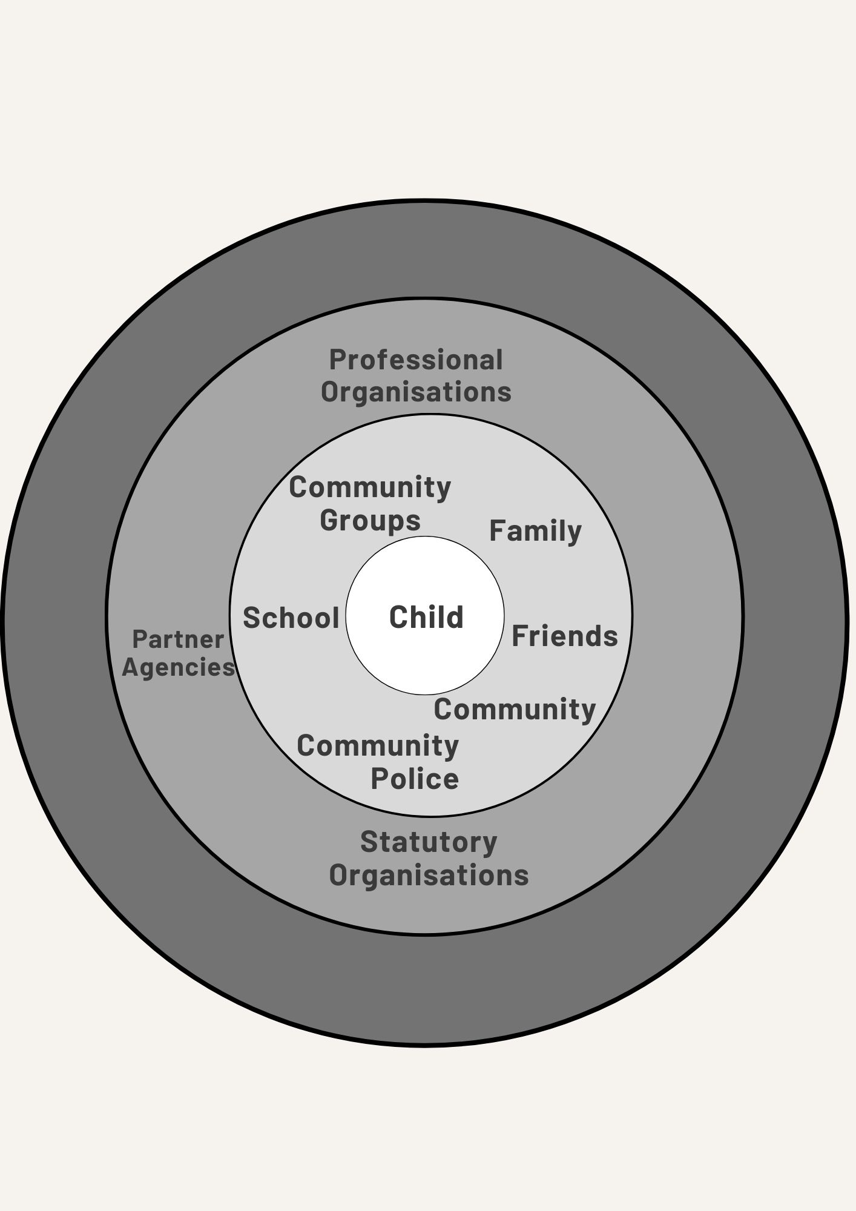
Crossing Boundaries Simplified Model:
The CB socio-ecological mapping makes explicit & visual if the child is central in terms of, access, consent and control of information. It highlights:
How and in what ways professionals seek to place the child at the centre but then consciously, or unconsciously, sideline the child or young person.
How individual professionals adopt group approaches outwith their professional role/identity.
We want to explore:
Can the tool be used by young people and those with Lived Experience?
Does the tool allow opportunity for those with Lived Experience to map their experiences (present and past) and a method to communicate vital information to themselves or to others.
CB simplified socio-ecological model example we gave:
Notes:
Delete unneeded comma. See yellow in line 2. Also other highlights – what do you think about posing the list as series of questions than can be answered? So just adding in a few words and ? Marks ?

Slide 6
Crossing Boundaries Simplified Model for Lived Experience
The CB simplified model has potential for identifying or highlighting where exploitation is occurring.
The child or young person could use it by themselves for their own information or share with others.
The tool may be useful at an early stage of a grooming and exploitation process and aid seeking early help.
Early help was highlighted by those with Lived Experience, youth or community orientated professionals and young people as significant.
Those with Lived Experience described current information gathering and sharing systems as ‘extractive’.
The Crossing Boundaries (CB) simplified model helped to make clear why some professionals are seen as more likely to be supportive with disclosure, exploitation and recovery.
The CB simplified model may offer an opportunity to disrupt that process.
Notes:
Looks great!

Slide 7
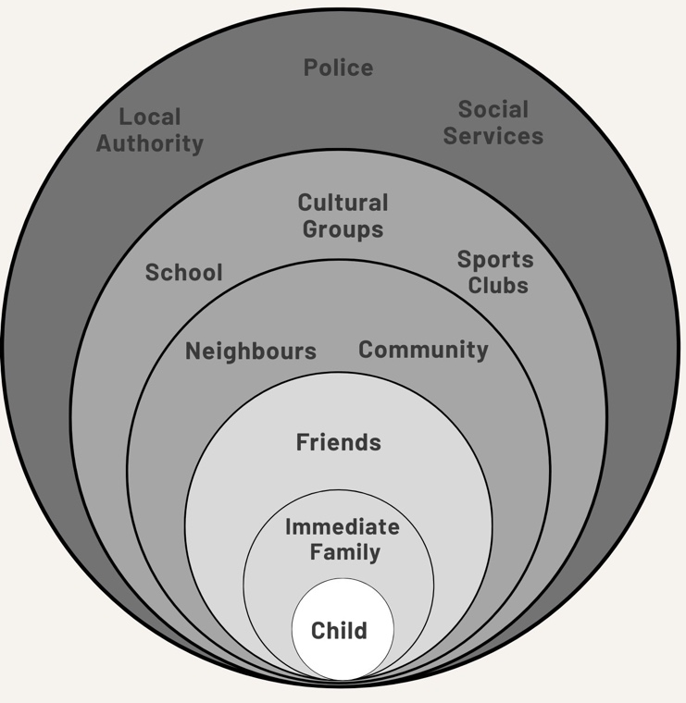
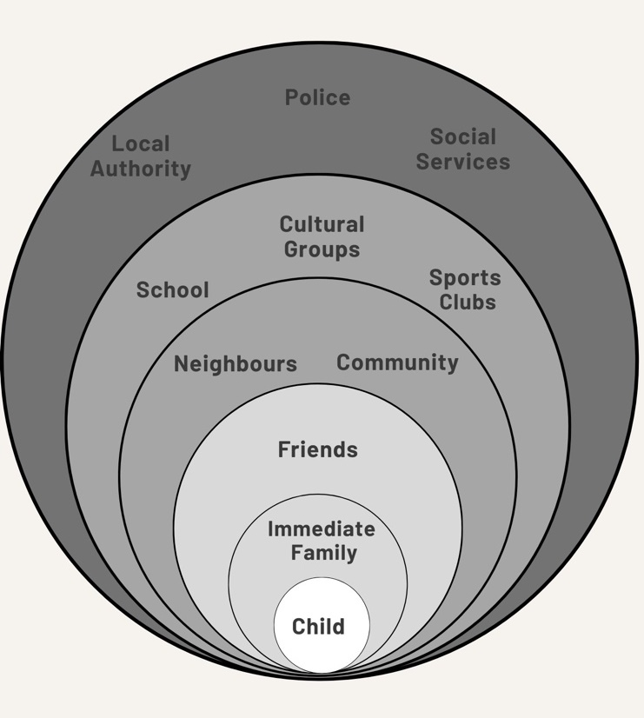
Crossing Boundaries Simplified Model for Lived Experience:
What does this show us?
People with LE use of the Crossing Boundaries Simplified Model showed who was most/least important in their lives when the grooming/exploitation process began.
The model shows who might have held important information and with whom information might or had been shared.
When using the CB simplified model in the future it would be important that the person with LE should judge who information should be shared with. For example, community can be both a positive place of support and a negative place of shaming and stigma. The community may hold vital information and could be helpful.
Once exploitation is occurring the map might be almost blank apart from the groomer(s)/exploiter(s). Using this tool a young person might draw and ‘see’ this for themselves. They may also be able to illustrate for others that those blanks exist and use it to talk about how those who are present for them have become very limited.
Lived Experience Socio-Ecological Map
Notes:
Coule of highlights for wording thoughts and also question in red

Slide 8
Concluding Thoughts
Crossing Boundaries found:
- this sort of research project takes time to build trust essential to encourage participation.
- exploitation continues and harms children, young people, families and communities.
- it is possible to find more inclusive, co-produced methods of sharing information.
These methods can create ways of supporting and working with children and young people at risk of exploitation and those with Lived Experience in ways they can control.
Finally:
We want to use and develop the ‘Crossing Boundaries Simplified Model’: Continue to co-develop it with those with Lived Experience, families, communities and professionals.
If you are interested in exploring this work with us, please contact Elaine at: Elaine.Arnull@solent.ac.uk
Those with Lived Experience and those experiencing exploitation want better targeted assistance and support available at a variety of points.
Those with Lived Experience, survivors and communities want change that is visible and tangible.
Those with Lived Experience, survivors and communities want to engage in discussion and consultation about effective ways to share information and minimise harm caused by exploitation.

Slide 9
Thank you for listening.
Contact:
Elaine Arnull, Professor of Social Sciences and Social Work.
The project has been funded by the Nuffield Foundation, but the views expressed are those of the authors and not necessarily the Foundation.
Elaine.Arnull@solent.ac.uk
Social Sciences and Nursing, Southampton Solent University, Southampton SO14 0YN, UK

