Slide 1
Nuffield Future Researchers 2020 Introduction to [Insert Project Supervisor name]
[Insert Project Supervisor job title]
[Insert Project Supervisor organisation/institution]

Slide 2
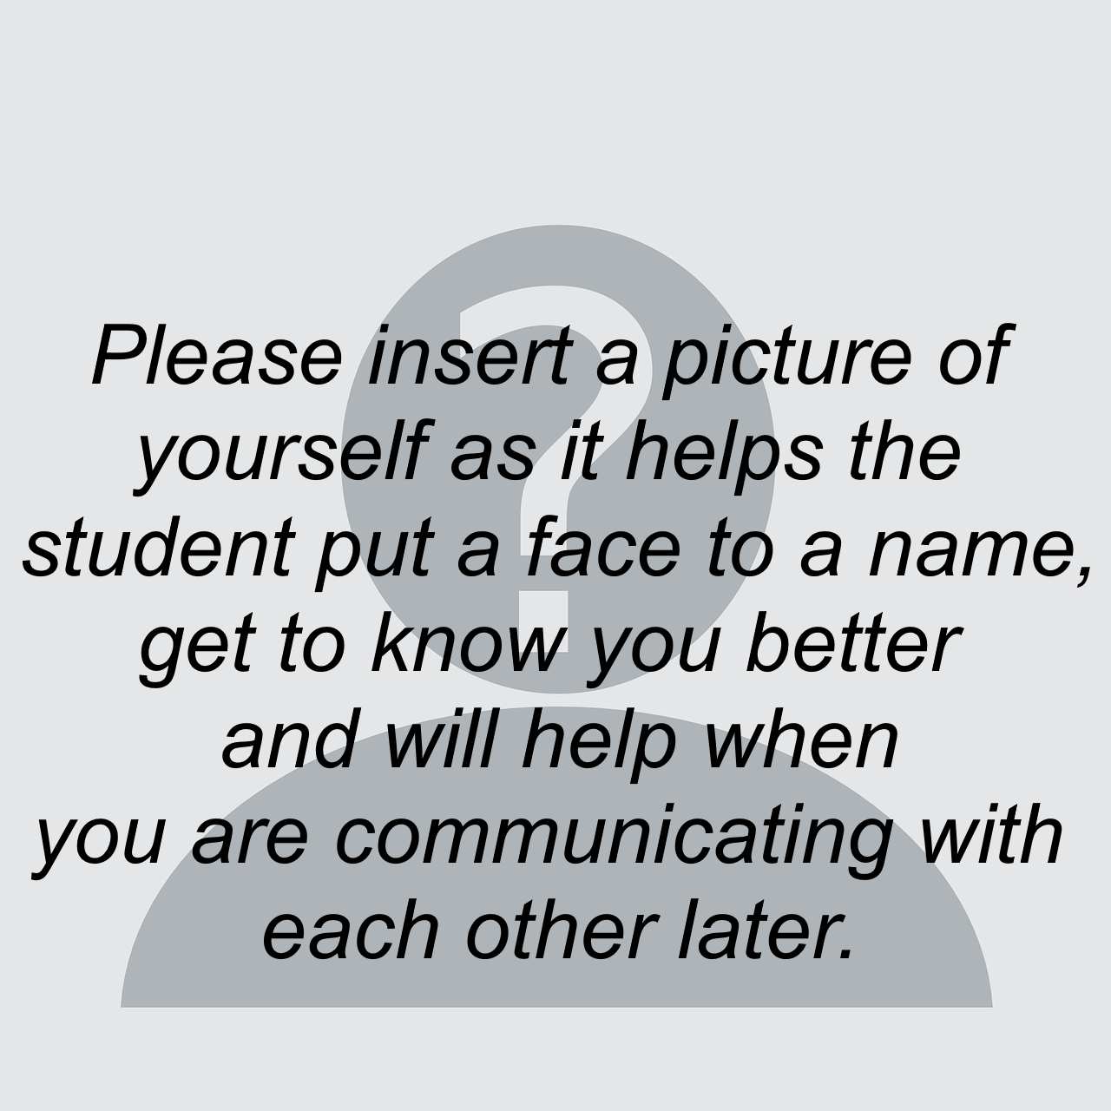
About me
Try to give a sense of who you are by providing details such as: -
How long have you worked in this role?
What is your area(s) of research?
What did you study as an undergraduate (and where)?
What’s been the best thing you’ve discovered as a researcher? (To help bring your work to life!)
Here are some useful links so you can find out more about:
Where I work >> www.placeofwork.uk/department
Me >> LinkedIn profile
Relevant professional social media accounts etc…

Slide 3
My colleagues
To give a sense of the team the student(s) may encounter, it may be helpful to provide information on your colleagues. You may simply want to list them and their roles or provide similar information to that in the slide “About me.”
How long have you worked in this role?
What is your area(s) of research?
What did you study as an undergraduate (and where)?
What’s been the best thing you’ve discovered as a researcher?
(To help bring your work to life!)
Here are useful links so you can find out more about:
Where I work >> www.placeofwork.uk/department
Me >> LinkedIn profile
Relevant professional social media accounts etc…

Slide 4
Setting expectations
Here you can help set expectations so that you and the student(s) can agree on how the project supervisor and student relationship will work. Try to give a few key pointers as the student(s) will feel more comfortable if they are clear on the boundaries.
What should the student(s) call you?
It’s good to be clear about names/titles and how you would like to be addressed. Students have been advised to address you formally in their first communication, but you may want this to change after that.
What dates will you be available from start to finish for the project?
Please be specific and include any dates when you are not around.
When will you be able to respond to queries?
Are you happy to do this on an ad-hoc basis or would you like to set some clear days/times when you will be able to answer any questions so the student(s) can ensure they’ve sent through/gathered all their queries in time?
How frequent would you like to communicate via video conference?
We encourage supervisors to hold regular video conference calls with their student(s) to maintain a successful and efficient relationship, but you may only be able to commit to once a week or once a fortnight, for example, so it’s good for the student(s) to be aware of this.
How would you like to handle the constructive feedback towards their report and poster?
Will you only want to see one final draft? Or will you be happy reviewing each section at a time as it is written? Will you be happy to feedback just once or a couple of times?

Slide 5
Your area of expertise
Lastly, it’s a good idea to introduce your particular subject area and the research question in a bit more detail so that the student(s) can start to immerse themselves in the topic.
Through what methods have you communicated your research previously?
Students may have a fixed idea of what constitutes published research so it’s great to start broadening their perspective on this.
What 3x articles/papers/documents/conference videos really get across your work and interests and that you would recommend the student(s) should read/watch?
Try not to make them too lengthy but with a good amount of detail so they can start to develop their subject-specific knowledge.

