Slide 1
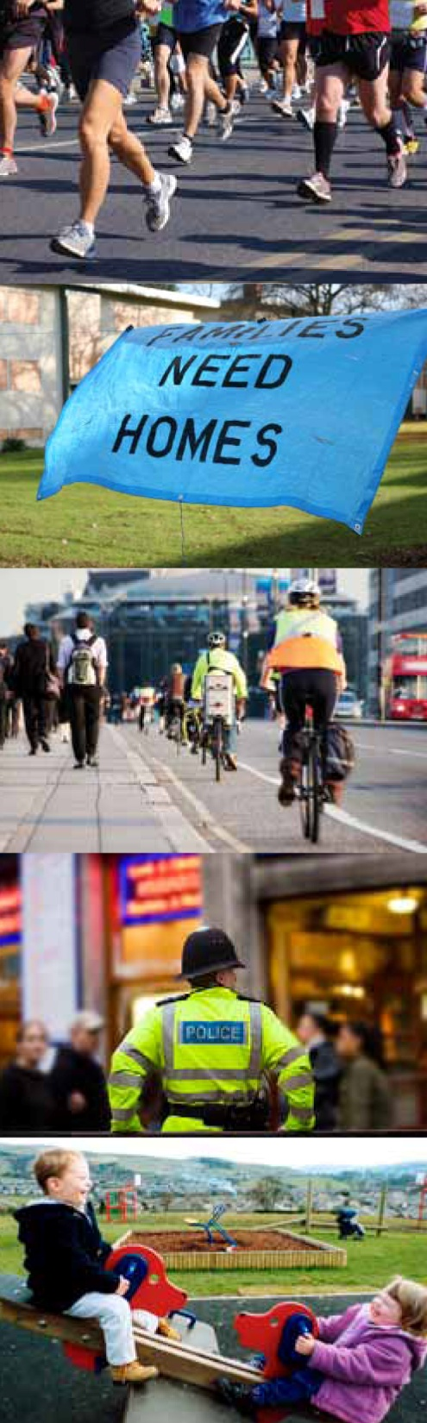



Out of School Activities and the Education Gap liz.todd@ncl.ac.uk k.j.c.laing@ncl.ac.uk http://www.natcen.ac.uk/our-research/research/out-of-school-activities/
Meg Callanan, Jenny Chanfreau, Karen Laing, Jonathan Paylor,
Amy Skipp, Emily Tanner, Liz Todd

Slide 2
Definitions
“Learning activity outside normal school hours that children take part in voluntarily”. (Department for Education)
Organised activities with adult supervision
e.g.,music lessons, sports clubs, after-school clubs, Brownies/Cubs

Slide 3
Why find out about out of school
activity?
An understanding of childhood & parenthood, their construction over time
Insight into the equalities and inequalities of childhood – availability/take-up of opportunities
Impact of out of school activity on children’s outcomes - well-being, health, attainment

Slide 4
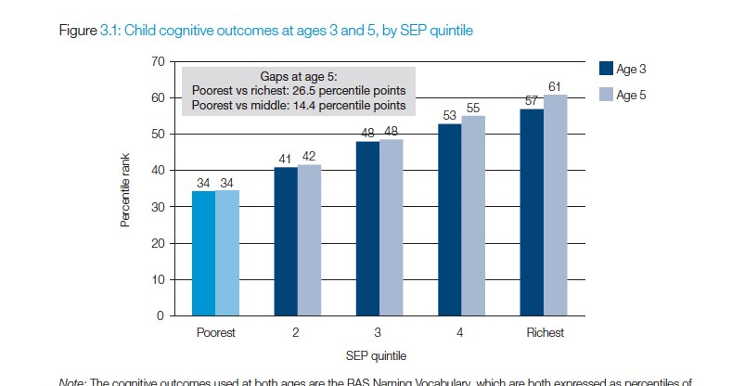
Attainment gap at different
income levels
Notes:
Page 19 Already by the age of 3 there are big differences in the cognitive outcomes of poor children compared to those from better-off backgrounds, and this gap widens by the age of 5 – as children from the richest backgrounds in particular continue to improve their performance relative to other children. Figure 3.1 shows the average percentile rank in the vocabulary element of the British Ability Scales (BAS) by quintile of parental SEP. Young children from the poorest fifth of families are ranked on average at around the 34th percentile at the age of 3. This is around 23 percentage points lower than the average rank among the richest fifth of children. This rich–poor gap has risen to nearly 27 percentile points by the time the children have reached the age of 5. Figure!3.1 shows that the middle–poor gap is also large.
This looks reasonable and the relationship is shown time and time again.
While the gap between the poorest children and children from better-off backgrounds grows less quickly across secondary school than primary, by the time young people take their General Certificates of Secondary Education (GCSEs), the gap between rich and poor is very large. For example, only 21% of the poorest fifth (measured by parental socioeconomic position; SEP) manage to gain five good GCSEs (grades A*–C, including English and maths), compared to 75% of the top quintile – an astonishing gap of 54 percentage points. Figure 5.1 highlights the gaps in educational attainment between young people from different socioeconomic backgrounds at ages 11, 14 and 16. It shows the average percentile rank of national Key Stage test scores by quintile of parental SEP. As shown in Chapter 4 for the primary school aged children in the ALSPAC cohort, there are already large and significant socioeconomic differences in educational attainment by age 11, and the further widening of these gaps in the teenage years is relatively small compared to earlier in childhood. By age 16, when test scores represent results at GCSE level (the first level of formal academic qualification in English schools),
4 large datasets of children, some involving parents, over different periods of time, different tests for the children and questions asked ch and parents, income recorded
4 datasets: 2000-7 Millenium cohort study 18k children born 2000 studied from 9mths to 5yrs
1991-2000 Avon Longitudinal study of parents and children ALSPAC 14k children born 1991/2 till 9yrs and parents
2003-7ish Longitudinal study of YP in England LSYPE 15k ch aged 13-14 in 2003-4 until they were 16
1970-2004 British Cohort Study on intergenerational transmission BSC 3.5K children all born April 1970 studies 5,10,16, 26, 29, 34
All of our work is based on a very simple model linking an indicator of potential financial (dis)advantage, namely parental SEP, to educational outcomes measured from age 3 to age 16 (see Figure 2.1). In this simple model, the main item of interest is to establish the importance of a number of parental and child attitudes and behaviours that may serve as ‘transmission mechanisms’ between material wellbeing and other measures of family background, and educational outcomes. These vary considerably according to the age of the child, and are summarised in Figure 2.1.
Research from large datasets of families over time has showed associations between attainment and attitudes at different income levels (Goodman and Gregg 2010)
Parent research appears to show the importance of focus on raising aspirations (Goodman and Gregg 2010; Desforges and Abouchaar 2003)
Just to show the data the studies are based on
The gap in attainment between the poorest children and children from better-off backgrounds, already large at age 5, grows particularly fast during the primary school years. By age 11, only around three quarters of children from the poorest fifth of families reach the government’s expected level at Key Stage!2, compared to 97% of children from the richest fifth. Poor children who perform well in Key Stage tests at age 7 are more likely than rich children to fall behind by age 11, and poor children who perform badly at age 7 are less likely to improve their ranking compared to children from better-off backgrounds, which is an important factor behind the widening gap.

Slide 5


Hypothesis
We hypothesise that children who take part in out of school activities do better educationally, and want to explore the processes underlying this link. We want to know if this link is important for disadvantaged young people.
Processes
Evidence

Slide 6
3 Stages
Define possible theories of change that might explain the benefits and dis-benefits of out of school activities for young people and specifically for attainment
Use MCS & NPD* to explore quantitative links between how children (both all children and those who are economically disadvantaged) spend their time and attainment
Use qualitative data from interviews with head teachers, providers, parents and children to explore possible theories of change for links between how) spend their time and attainment
*University of London. Institute of Education. Centre for Longitudinal Studies, Millennium Cohort Study: Linked Education Administrative Dataset (KS1 & KS2), England: UK Data archive Secure Access.

Slide 7
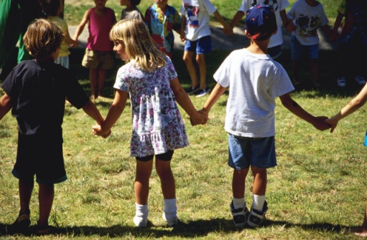
Theories
Possible theories of causation from our review of the literature
Which theories are most likely to underpin these links?
There are a wide range: theories are grouped as
  child-related (self-belief, goal theory, capability)
  social context (socio-cultural,
  risk-resiliance, social capital)
  activity-related (competition related,
  academic related),

Slide 8
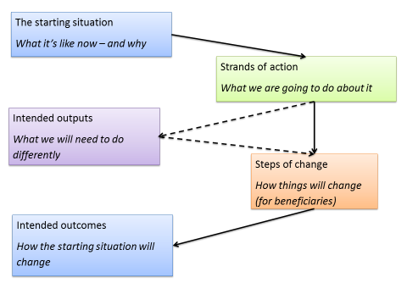




Slide 9
Qualitative research
Research questions:
What are the drivers and barriers that influence how children spend their time when not in the classroom.
What are the benefits or dis-benefits of out of school activities?
Is there a perceived link with educational attainment?
Interviews and focus groups with head teachers, activity providers, parents and children in schools in Newcastle and London
All schools selected either high proportion of FSM or diverse populations

Slide 10
Millenium cohort study MSC
The MSC follows the lives of 19,000 children born in 2000/1 in the UK. Five sweeps of data available so far.
Certain sub-groups intentionally over-sampled, in particular those living in disadvantaged circumstances, children from minority ethnic backgrounds (in England), and youngsters growing up in the smaller countries of the UK, namely Scotland, Wales and Northern Ireland.
Data also on child and family characteristics
We have looked at 5, 7, 11 corresponding to the beginning of primary school, the end of key stage 1 and the end of key stage 2 (the final year of primary school)
Notes:
'Black':BlackCaribbean,BlackAfricanandBlackOtherasreported on the Census form;
b) 'Asian':Indian,PakistaniandBangladeshiasreportedontheCensus form.
The Child Poverty Index (CPI) used for stratification (see 3.3) is defined as the percentage of children under 16 in an electoral ward living in families that were, in 1998, receiving at least one of the following benefits:
Income Support;
Jobseekers Allowance;
Family Credit;
Disability Working Allowance.
parenting; childcare; school choice; child behaviour and cognitive development; child and parental health; parents’ employment and education; income and poverty; housing, neighbourhood and residential mobility; and social capital and ethnicity

Slide 11
Millennium Cohort Study linked to the
National Pupil Database
How children spend their time out of school - range and types
Change and continuity during primary school
Patterns of activities for children from different backgrounds
Associations between different activities and educational attainment at 11
Controlling for selection effects

Slide 12
State of the evidence
Just over ¾ children took part in sports classes, music tuition, ethos led groups and academic tuition in KS2
Participation was related to higher maternal qualifications, better home learning environment and father’s socio-economic status (Sylva et al, 2008, EPPE)
Participation in learning outside of school hours was a predictor of progress in Maths and English between the ages of 7 and 11, after controlling for background characteristics (Sylva et al, 2008)
Notes:
differences according to gender, ethnicity and mother’s working patterns
Department for Education’s survey of parents’ use of childcare (Huskinson et al, 2013).
Just over ¾ children took part in sports classes, music tuition, ethos led groups and academic tuition in KS2
Participation was related to higher maternal qualifications, better home learning environment and father’s socio-economic status (Sylva et al, 2008, EPPE)
A link between family characteristics and uptake, including the Growing Up in Ireland study (McCoy et al, 2012: Wikeley et al, 2007).
67 per cent of 8-11 year olds were in some form of childcare outside of school hours. Nearly half the children attended an after-school club and 29 per cent received informal childcare by family and friends (2011)
Participation in learning outside of school hours was a predictor of progress in Maths and English between the ages of 7 and 11, after controlling for background characteristics (Sylva et al, 2008) also Cummings et al 2011

Slide 13
“Over 3000 students in years 6, 11 and 13 completed a questionnaire survey of the nature and extent of private tuition in school curriculum subjects, their views about and evaluations of private tuition and demographic information. In the sample as a whole 27% of students had a private tutor and there was no significant difference between the year groups”
Mapping the nature and extent of private tutoring at transition points in education
Judith Ireson and Katie Rushforth, BERA Paper, 2004.

Slide 14
Change… and inequalities
From 2009 to 2014, the pro- portion receiving private or home tuition has increased from 20% to 23% (the figure in 2005 was 18%).
A 12% gap between the most and least affluent families
2009, 40% of young people in London reported having received private tuition, compared with an average of 17% in the rest of the country. In 2014, this gap has narrowed slightly but remains large (37% vs. 20%)
Sutton Trust (2014) from Ipsos MORI annual survey 2005 to 2,700 young people (between the ages of 11-16) England and Wales
Children already receiving private school education substantially more likely to additionally receive private tuition outside school (27% vs. 14%) (YouGov survey of 1,173 parents of chil- dren aged 5-16)
Notes:
Every year since 2005, the Sut-
ton Trust has commissioned Ipsos
MORI to survey around 2,700
young people (between the ages
of 11-16) in England and Wales on
their experience of education.
2
In
2005, and from 2009-2014, these
young people were asked wheth-
er they had ever received private
or home tuition.
Sutton Trust in 2013 by Professors Becky Francis and Merryn Hutchings,

Slide 15
What we know….
List on survey: Sports/exercise, Scouts/Guiding, Dance/Drama, Music, Social club, Arts and crafts, Science, Languages, and ‘other’
Majority of 76%: child regularly participated in some form of extra-curricular activity in the last 12 months.
Most popular: sport/exercise (52%), Scouts/Guiding (16%), dance/ drama (15%) and music (14%).
The majority of all parents report some participation
A 15% gap between social groups - A, B, or C1 (84%) vs C2, D, or E (69%).
Differences by parents’ level of education: 83% parents with a degree level education or higher vs 72% without a degree
Ipsos MORI surveyed 309 parents of children aged 5-16 in 2014
Notes:
Ipsos MORI surveyed 309 parents of children aged 5-16,5 asking whether a particular child (the child with
the most recent birthday) had regularly participated in any of a number of extra-curricular social activities outside of school in the last 12 months. The list of ac- tivities included Sports/exercise, Scouts/Guiding, Dance/Drama, Music, Social club, Arts and crafts, Science, Languages, and ‘other

Slide 16
Understanding the differences
Fee for activities
Cost of travel
Resulting responsibilities in the home
Gill year 9 “I don’t feel responsible, I just feel like, I feel bad leaving. I don’t want to leave my mum in case social services turn up or like the bailiffs and that. I don’t want that happening. I want to make sure my stuff is all there.”
Mushcamp et al 2011

Slide 17
MSC Findings: Extra tuition
More common with age: 5% at 7yr, 22% at 11yr (girls slightly more likely)
At age 7, main differences were by ethnic group: Indian 20%; White (3%)
At age 11 differences remain: Indian (42%); White (20%); Black (47%); other, including Chinese (48%)
Extra tuition most common amongst children whose mother had postgraduate degree (30%) and least common where their mother had no qualifications (19%)

Slide 18
Music tuition
43% children whose mother had postgrad degree had music lessons vs 6% children with no qualifications
26% children in households with income above poverty line had music lessons vs 4% poor children

Slide 19
Organised physical activity
Increase with age: 53% 5yr, 67% 7yr, 73% 11
Age 5 girls 57%, boys 50% but age 11 girls 71% and boys 74%
Most common if more educated parent: at age 11, 85% of children whose mother had undergrad degree did an organised physical activity at least weekly outside school vs 56% children with no formal qualifications. Age 5 (73% vs 22%). Age 7 (34% vs 85%)

Slide 20
Breakfast and after school clubs
Increase with age: 5yrs 5% to breakfast clubs, 11% to after school clubs
11yrs: 13% to breakfast clubs, 31% to after school clubs
Take-up higher with parents of full-time working parents, but this difference reduced with age of child
Perhaps greater availability of clubs at age 11 rather than age 5?

Slide 21
Other findings
30% children in informal childcare, 4-7% in formal childcare, relatively stable over time
TV time stable over the primary years 5-11: 82% watching 3hrs per day
Computer gaming increased with age: 22% age 5, 47% age 11 and gender difference boys 62% , girls 33% spending more than an hour per day
Reading for pleasure girls 53%, boys 36%
Spending time with friends out of school increased with age
Homework time at age 11 varied with ethnicity, spending 1-2hrs per week: Indian (24%); White (7%); Black (20%); other, including Chinese and other ethnic groups (25%)
Children doing household chores at age 11: 78% at least weekly and 53% several times a week
Caring commitments at age 11 (looking after elderly, sick or disable family members at least weekly: 11%

Slide 22
Key MSC Findings so far….
Extra tuition high in primary age and more common as children grew, from 7 (5%) to 11 (22%)
At age 7, main differences were by ethnic group: Indian 20%; White (3%)
At age 11 differences remain: Indian (42%); White (20%); Black (47%); other, including Chinese (48%)

Slide 23
Conclusions - questions
Do ethnic differences in private tuition - rather than school tuition - contribute to educational success of children in these groups?
Do differences in confidence in the school, worry about childhood, preferences for how to support your child – contribute to an explanation of ethnicity differences?
Are differences in take-up of music explained by income differences?
Are age differences explained by changes social and educational policy, or parenting discourse?
How do different out of school activities contribute to educational attainment - and to the attainment of different groups?

Slide 24
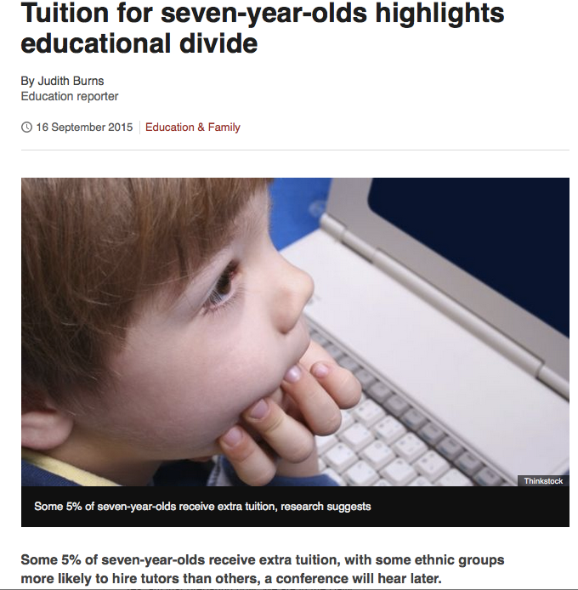


Slide 25
Acknowledgments
This study is funded by the Nuffield Foundation.
The Millennium Cohort Study and linked NPD data were made available by the UK Data Service.
  University of London. Institute of Education. Centre for Longitudinal Studies, Millennium Cohort Study: Linked Education Administrative Dataset (KS1), England: Secure Access [computer file]. 2nd Edition. Colchester, Essex: UK Data Archive [distributor], June2015 SN: 6862, http://dx.doi.org/10.5255/UKDA-SN-6868-3
  University of London. Institute of Education. Centre for Longitudinal Studies, Millennium Cohort Study: Linked Education Administrative Dataset (KS2), England: Secure Access [computer file]. Colchester, Essex: UK Data Archive [distributor], April 2015 SN: 7712, http://dx.doi.org/10.5255/UKDA-SN-7712-1

Slide 26
References
Cummings, C., Laing, K., Law, J., McLaughlin, J., Papps, I., Todd, L. and Woolner, P. (2011). Can changing aspirations and attitudes impact on educational attainment: A review of interventions. Joseph Rowntree Foundation.
Cummings, C., Todd, L., Dyson, A., Muijs, D., Papps, I., Pearson, D., Raffo, C., Tiplady, L., Crowther, D. Evaluation of the full service extended schools initiative: final report. Nottingham: Department for Education and Skills, 2007. DfES Research Brief and Report 852.
Cummings, C., Dyson, A., and Todd, L. (2011) Beyond the School Gates: Can full service and extended schools overcome disadvantage? Routledge: London & New York.
Eccles, J. S., Barber, B. L., Stone, M. & Hunt, J. (2003). Extracurricular activities and adolescent development. Journal of Social Issues, 59(4): 865-889.
Feldman, A. F. and Matjasko, J. L. (2005) The role of school-based extra-curricular activities in adolescent development: a comprehensive review and further directions. Review of Educational Research 75(2): 159-210.

Slide 27
Gregg, P. and Goodman, A. (2010) Poorer children’s educational attainment: how important are attitudes and behaviours? Joseph Rowntree Foundation.
Huskinson, T., Pye, J., Medien, K., Dobie, S., Ferguson, C., and Gardener, C. (2013). Childcare and Early Years Survey of Parents 2011. DfE: SFR08/2013.
Marsh, H. W. and Kleitman, S. (2002). Extracurricular school activities: The good, the bad and the nonlinear. Harvard Educational Review 72(4): 464-515
Stearns, E. and Glennie, E. J., (2010) Opportunities to participate: Extracurricular activities’ distribution across and academic correlates in high schools. Social Science Research 39 (2): 296-309.
Sutton Trust (2014) Research brief. Extra-curricular inequality.
Sylva, K., Melhuish, E. C., Sammons, P., Siraj-Blatchford, I. and Taggart, B. (2008). Final Report from the Primary Phase: Pre-School, School and Family Influences on Children’s Development during Key Stage 2 (7-11). DCSF Research Report 61.
Wikeley, F., Bullock, K., Mushamp, Y. and Ridge, T. (2007). Educational relationships outside school: Why access is important. Joseph Rowntree Foundation.
Wikeley, F., Bullock, K., Muschamp, Y., and Ridge, T. 2011. Educational relationships and their impact on poverty. International Journal of Inclusive Education, 13 (4), 377-393.

