Slide 1




Out of School Activities and the Education Gap
Meg Callanan, Jenny Chanfreau, Karen Laing, Jonathan Paylor, Amy Skipp, Emily Tanner, Liz Todd

Slide 2
Definitions
“Learning activity outside normal school hours that children take part in voluntarily.” (Department for Education)
Organised activities with adult supervision
music lessons
sports clubs/ lessons/ training
Breakfast/ after-school clubs
Brownies/Cubs

Slide 3


Hypothesis
We hypothesise that children who take part in out of school activities do better educationally, and want to explore the processes underlying this link. We want to know if this link is important for disadvantaged young people.
Processes
Evidence

Slide 4
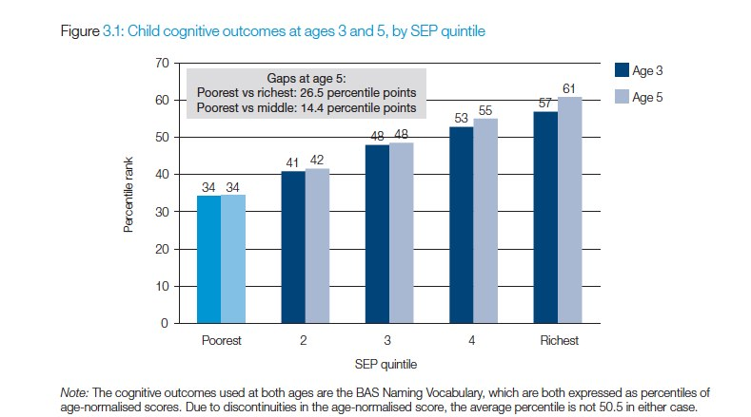
Attainment gap: cognitive ability at age 3 & 5 by socio-economic position
Source: Dearden, L., Sibieta, L., & Sylva, K. (2010) Ch 3 3 From birth to age 5: evidence from the Millennium Cohort Study. In http://www.jrf.org.uk/system/files/poorer-children-education-full.pdf
Notes:
A reminder of the attainment gap – economically disadvantaged children face an educational disadvantage.
This analysis of MCS data by a team of academics shows already when starting primary school children from poor backgrounds have poorer cognitive ability scores (measured using the British Ability Scales - Naming Vocabulary scores).
*Note: authors constructed SEP using PCA on log-transformed household income (average over time), reported experience of financial difficulties; mother’s and father’s occupational class & housing tenure.

Slide 5
3 Study Components
Literature review of Theories of Change
2. Analysis of Millennium Cohort Study & NPD*
Activities asked about during primary: 5, 7 & 11 years Attainment at KS1 & KS2 (England)
Qualitative case studies in 8 schools
Interviews with head teachers, activity providers, inclusion managers and parents. Focus groups with children.
*University of London. Institute of Education. Centre for Longitudinal Studies, Millennium Cohort Study: Linked Education Administrative Dataset (KS1 & KS2), England: UK Data archive Secure Access.
Notes:
* 3 components to our study:
1) Review of what academic theories have already been suggested to explain the link between out of school activities and attainment
2) Quantitative analysis of Millennium Cohort Study data that has been linked to the National Pupil Database to investigate patterns of participation in organised activities among children from different backgrounds and whether participation in certain activities is linked to attainment at the end of primary school.
This is the youngest of the UK’s cohort studies – about 19,000 children born between Sept 2000 and January 2002 were sampled to take part and a wealth of information has been collected about the children and their families through interviews when the children were 9 months and again at ages of 3, 5, 7 and 11 years old.
For children in England whose parents gave consent to link their survey answers to the NPD we also have attainment data for KS1 and KS2. We have used some data from all 5 sweeps of data collection but focus is on activities at age 5, 7 and 11 and attainment at KS2.
That’s the focus of today but project as a whole also includes…
3) Qualitative school case studies to provide a more nuanced understanding the reasons for variations in what children do from different perspectives – school and provider staff, parents and children themselves.

Slide 6
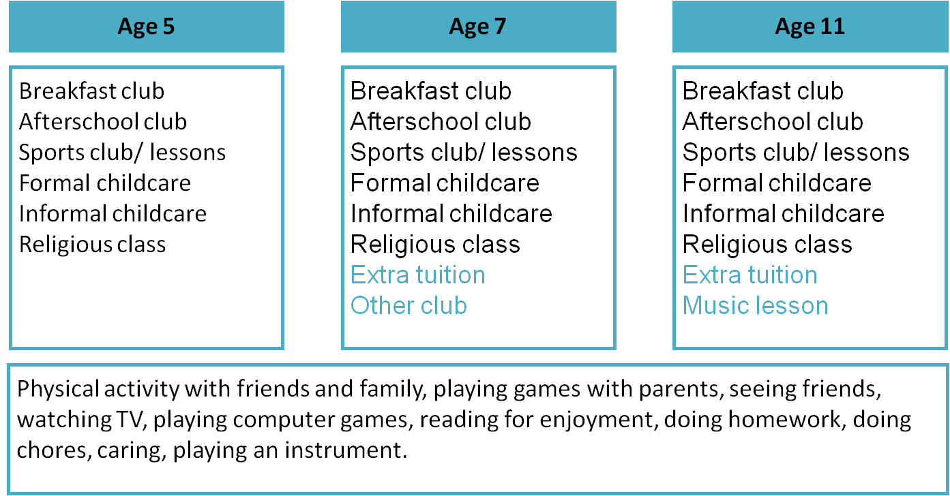
Out of School Activities in MCS

Slide 7
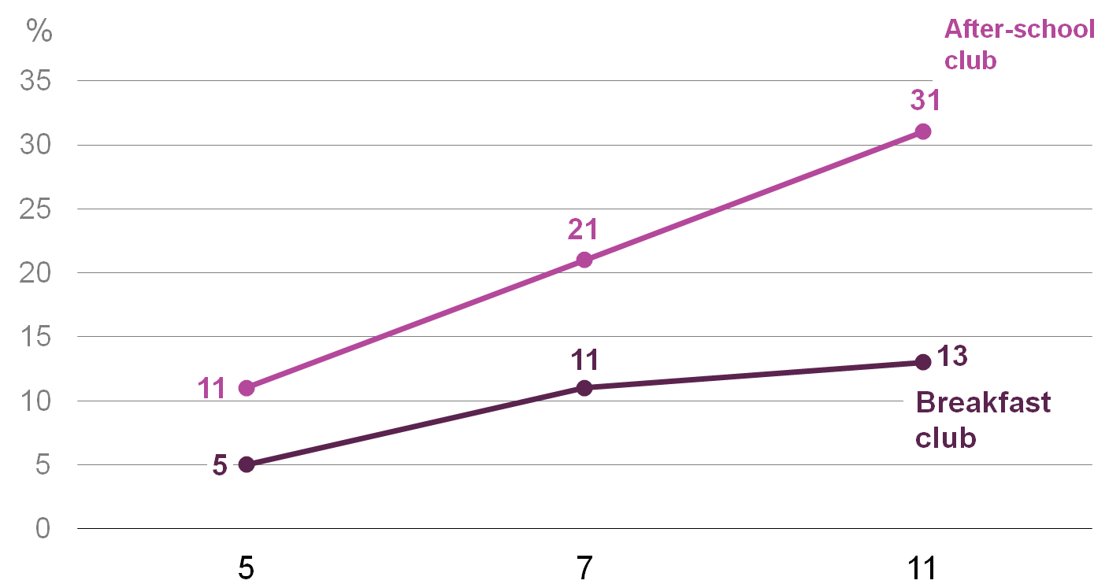
Wrap-around clubs in MCS
Base: All children taking part at age 5, 7 & 11
Notes:
A general trend that we see in the data - where we have information about an activity at three time points – is increasing take-up as the children grow older.
One reason for the increase in take-up of clubs might be increased availability and accessibility of the clubs?
The next stage for us was then to look at patterns in terms of which children did multiple activities and whether certain activities clustered together.

Slide 8
Who does what? Typology of activities in MCS
Self-directed social 30% School clubs, friends, screen time Hobbies 26% Sport, music, other clubs, no childcare
Granny & Sport 19% Informal childcare, sport
Extra instruction 14% Religious activity, tuition
Extended school day 8% School clubs for childcare, sport
Busy & highly structured 5% Childcare, tuition, music, sport
For more detail on the typology see natcen.ac.uk/media/563160/out of school-resbr2.pdf
Notes:
Used a technique Latent Class Analysis to group children based on the organised out of school activities they took part in during the primary school years, so at ages 5,7 and 11 in the MCS data. We found a 6-cluster solution and named the groups:
Self-directed social – the largest cluster –average level of take up of breakfast and after school clubs but was less likely to take part in other formal activities and this group was least likely to do multiple activities. When we looked at other characteristics - children in this cluster had more unstructured social time with friends and more screen time than the children in the other groups. About half of the children in this group were from a disadvantaged background.
Hobbies - This group of children had a high level of participation in sports, music and other clubs but were not likely to use any form of childcare.
Granny & Sport – The defining characteristic of this group is the high proportion using informal childcare. The majority of these children also did organised sports.
Extra instruction – The majority of these children attended religious activities and/or classes at least weekly. A higher than average proportion of this group also received extra tuition. This group also included a higher than average proportion of children from a disadvantaged background.
Extended school day – high level of take-up of breakfast and afterschool clubs, along with sports clubs.
Busy & highly structured – higher than average level of formal childcare, along with higher than average take up of extra tuition and music lessons and the majority also did sports clubs.

Slide 9
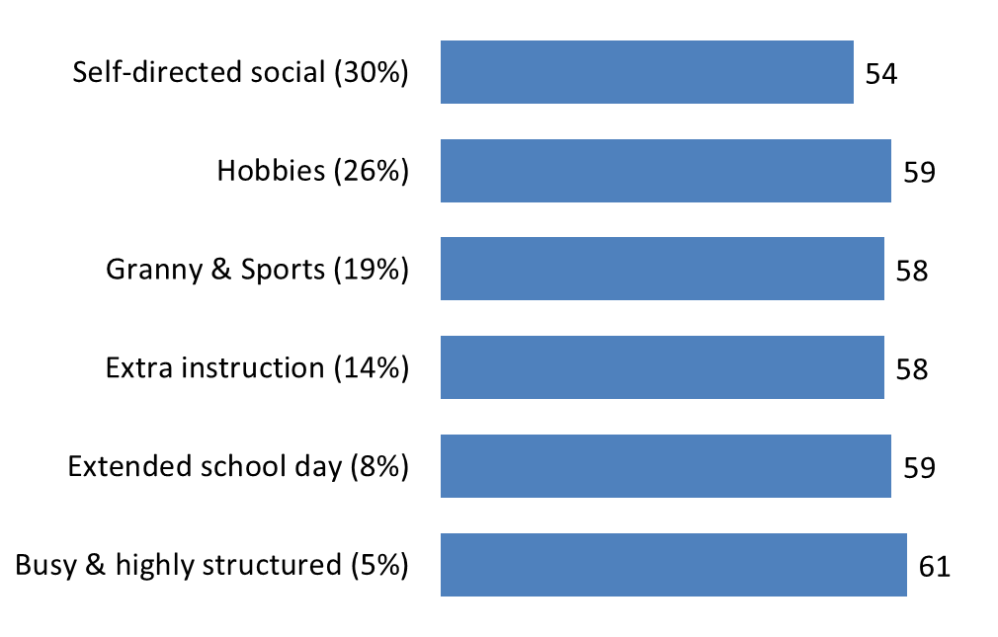
Typology of activities in MCS and KS2 attainment
Smallest n=297 (Busy & highly structured)
For more detail on the typology see natcen.ac.uk/media/563160/out of school-resbr2.pdf
Notes:
Having mapped out how take-up of different activities differed across groups of children we were interested to see how attainment differed between the groups.
This chart shows the unadjusted average KS2 Total point score for the clusters
KS2 Total point score – sum of points awarded for each level – which in our data ranges from 0 to 78 with a mean of 57 points overall. (78 is 2 x L6)
So KS2 attainment is highest among the busy & highly structured (61 points) and quite clearly lowest among self-directed social (54 points). For comparison – there is a 6-point difference between National Curriculum levels – so a bit more than the difference between a Level 4 and Level 5 in one subject.
Of course much of this variation is down to differences in the economic and other home circumstances of the children in these different groups. We can’t say how much – if any at all can be attributed to the activities rather than home differences.

Slide 10
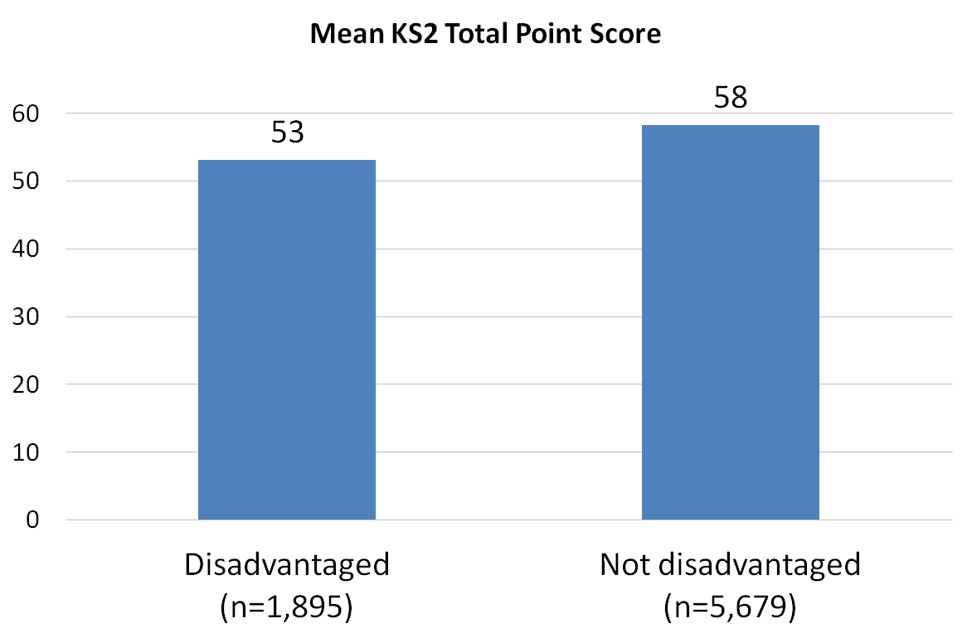
Focus on disadvantage and the attainment gap
Disadvantage: low income family(<60% median) at 2 or 3 time points during primary school (25% of the kids)
Notes:
A key aspect of our project is understanding whether out of school activities may play a role in reducing the attainment gap.
For this project we have defined disadvantage as living on a low family income in at least two time points that we have data for – i.e. at ages 5,7,11. (Low income is defined as below the poverty threshold (below 60% of median equivalised income indicator available on the MCS dataset) – slightly different from free school meals indicator but highly correlated. (About half of these disadvantaged pupils were eligible for Free School Meals at age 7 and/or 11 (53% at age 7 and 51% at age 11) – by comparison overall 16-17% of children were eligible for FSM at those age points.)
Chart shows - about a 5 point attainment gap between disadvantaged and not disadvantaged kids. (Equivalent to just less than a one-level difference.)

Slide 11
Emerging findings: attainment among disadvantaged pupils
Early findings suggest that among disadvantaged children, taking part in after-school club is related to attainment.
Other informal activities also related to disadvantaged children’s attainment.
Notes:
So to understand the role of organised activities among disadvantaged children we have run regression models of KS2 Total point score including only disadvantaged pupils. Regression modelling allows us to statistically ‘control’ for other differences to see whether taking part in an activity is related to attainment.
Among disadvantaged children:
Taking part in after-school club(s) either at all age points (5,7 & 11) or starting after the age of 5 and then continuing is associated with higher total point score at KS2, on average. And this effect is increased slightly when controlling for KS1 APS.
No other organised activities significantly related to attainment.

Slide 12
Next steps
Behavioural and emotional outcomes at age 11
Analysing qualitative data
Revisit theories of change in light of findings
Reporting final findings 2016

Slide 13
Questions & Discussion
What is it about after-school clubs for disadvantaged children?
What kinds of activities could this include? (2006, 2008, 2012)
Why might after-school clubs play a role in attainment specifically for disadvantaged children?
What implications could these findings have for schools?
Any other comments?
Notes:
That was all I wanted to cover today – happy to take any questions
Also love to hear your thoughts on any of the findings. Particularly puzzling over what to make of the importance of after-school attendance for disadvantaged kids.

Slide 14
Acknowledgments & more info
For more information visit http://www.natcen.ac.uk/our-research/research/out-of-school-activities/ or sign up to our contacts list.
The Millennium Cohort Study and linked NPD data were made available by the UK Data Service.
University of London. Institute of Education. Centre for Longitudinal Studies, Millennium Cohort Study: Linked Education Administrative Dataset (KS2), England: Secure Access [computer file]. Colchester, Essex: UK Data Archive [distributor], April 2015 SN: 7712, http://dx.doi.org/10.5255/UKDA-SN-7712-1
Notes:
At end - acknowledge – v grateful to UK Data Service and Centre for Longitudinal Study for making MCS & NPD data available to us for analysis and also to Nuffield Foundation for the research funding.
Thank you – if want more info – research briefs on project page
or sign up on contacts list

