Slide 1







Lessons for Mathematical Problem Solving
- LeMaPS
Geoff Wake and Malcolm Swan
Centre for Research in Mathematics Education
University of Nottingham, England

Slide 2
Outline
What do we mean by problem solving?
What key processes are involved?
How can Lesson Study contribute to improve the teaching and learning of problem solving?
What are the challenges involved?
How can LeMaPS meet these challenges?

Slide 3
What is a problem?
“ A problem is a task that the individual wants to achieve, and for which he or she does not have access to a straightforward means of solution.”
(Schoenfeld, 1985)
“ .... problems should relate both to the application of mathematics to everyday situations within the pupils' experience, and also to situations which are unfamiliar.”
(Cockcroft, 1982, para 249)
Notes:
Schoenfeld, A.H 1985 Mathematical Problem solving, Orlando, Fl. Academic
249 The ability to solve problems is at the heart of mathematics. Mathematics is only 'useful' to the extent to which it can be applied to a particular situation and it is the ability to apply mathematics to a variety of situations to which we give the name 'problem solving'. However, the solution of a mathematical problem cannot begin until the problem has been translated into the appropriate mathematical terms. This first and essential step presents very great difficulties to many pupils - a fact which is often too little appreciated. At each stage of the mathematics course the teacher needs to help pupils to understand how to apply the concepts and skills which are being learned and how to make use of them to solve problems. 249 The ability to solve problems is at the heart of mathematics. Mathematics is only 'useful' to the extent to which it can be applied to a particular situation and it is the ability to apply mathematics to a variety of situations to which we give the name 'problem solving'. However, the solution of a mathematical problem cannot begin until the problem has been translated into the appropriate mathematical terms. This first and essential step presents very great difficulties to many pupils - a fact which is often too little appreciated. At each stage of the mathematics course the teacher needs to help pupils to understand how to apply the concepts and skills which are being learned and how to make use of them to solve problems. These problems should relate both to the application of mathematics to everyday situations within the pupils' experience, and also to situations which are unfamiliar. For many pupils this will require a great deal of discussion and oral work before even very simple problems can be tackled in written form.

Slide 4
Developing Mathematical Literacy…
“An individual’s capacity to formulate, employ, and interpret mathematics in a variety of contexts. It includes reasoning mathematically and using mathematical concepts, procedures, facts and tools to describe, explain and predict phenomena.
It assists individuals to recognise the role that mathematics plays in the world and to make the well-founded judgments and decisions needed by constructive, engaged and reflective citizens.”
(PISA 2015 Mathematics Framework; OECD)
Notes:
This definition was developed by the Expert Group for Mathe- matics of the Programme for International Student Assessment (PISA)
http://www.maa.org/sites/default/files/pdf/QL/pgs75_89.pdf

Slide 5
Mathematical literacy (PISA, 2015)
Problem in context
Mathematical problem
Formulate
Employ
Evaluate
Results in context
Interpret
Mathematical results
“The modelling cycle is a central aspect of the PISA conception of students as active problem solvers”
Notes:
The focus … is on active engagement in mathematics, and is intended to encompass reasoning mathematically and using mathematical concepts, procedures, facts and tools in describing, explaining and predicting phenomena.
In particular, the verbs ‘formulate,’ ‘employ,’ and ‘interpret’ point to the three processes in which students as active problem solvers will engage. Formulating situations mathematically involves identifying opportunities to apply and use mathematics – seeing that mathematics can be applied to understand or resolve a particular problem or challenge presented. it includes being able to take a situation as presented and transform it into a form amenable to mathematical treatment, providing mathematical structure and representations, identifying variables and making simplifying assumptions to help solve the problem or meet the challenge. Employing mathematics involves applying mathematical reasoning and using mathematical concepts, procedures, facts and tools to derive a mathematical solution. It includes performing calculations, manipulating algebraic expressions and equations or other mathematical models, analysing information in a mathematical manner from mathematical diagrams and graphs, developing mathematical descriptions and explanations and using mathematical tools to solve problems. Interpreting mathematics involves reflecting upon mathematical solutions or results and interpreting them in the context of a problem or challenge. It includes evaluating mathematical solutions or reasoning in relation to the context of the problem and determining whether the results are reasonable and make sense in the situation.

Slide 6
Formulating situations mathematically
Problem in context
Mathematical problem
Formulate
Identifying significant variables, constraints;
Simplifying a situation; making assumptions;
Recognising structure in situations;
Representing a situation mathematically, using words, symbols, graphs;
Making connections with known problems or
mathematical concepts, facts, or procedures
(PISA, 2015)

Slide 7

Making reasonable estimates
There are about 60 million people in the UK.
About how many schoolteachers are there?
Notes:
In “YOu reckon”
A bank manager says that an armed youth stole a bag containing ｣5000 in ｣1 coins and ran away.The insurance company are suspicious, and want you to investigate. Could the bank manager be lying?Explain your reasoning carefully! Tell the insurers exactly what information you used, and what assumptions you made.

Slide 8


Slide 9
Formulating
Identifying significant variables and making assumptions
- Size of population p 60,000,000
- How long do you go to school t 12 years
- Average lifespan n 80 years
- Size of class c 25
Derive relationships and facts
  - Fraction of population at school t ÷ n 1/7
  - School population p (t ÷ n) 8,500,000
  - Number of teachers p (t ÷ n) ÷ 25 340,000

Slide 10
Employing concepts, facts, procedures and reasoning
devising and implementing strategies;
using mathematical tools, including technology;
applying mathematical facts, rules, algorithms, and structures;
Creating and manipulating mathematical diagrams, graphs, and constructions and extracting information from them;
using and switching between representations;
making generalisations based on the results;
reflecting on mathematical arguments and explaining and justifying results.
Mathematical problem
Employ
Mathematical results
(PISA, 2015)

Slide 11
Interpreting, applying and evaluating
interpreting results back into the real world context;
evaluating the reasonableness of a mathematical solution in the context;
explaining why a mathematical result or conclusion does, or does not, make sense in the context;
identifying and critiquing the limits of the model.
Problem in context
Evaluate
Results in context
Interpret
Mathematical results
(PISA, 2012)

Slide 12
The centrality of these processes in PISA
The definition of mathematical literacy refers to an individual’s capacity to formulate, employ, and interpret mathematics.
Items in the 2015 PISA mathematics survey will be assigned to one of three mathematical processes:
Formulating situations mathematically;
Employing mathematical concepts, facts, procedures, and reasoning;
Interpreting, applying and evaluating mathematical outcomes.
It is important for both policy makers and those engaged more closely in the day-to-day education of students to know how effectively students are able to engage in each of these processes.

Slide 13

The New National Curriculum for England
  “Mathematics is an interconnected subject in which pupils need to be able to move fluently between representations of mathematical ideas.”
  “The programmes of study are, by necessity, organised into apparently distinct domains, but pupils should make rich connections across mathematical ideas to develop:
    fluency,
    mathematical reasoning,
    competence in solving increasingly sophisticated problems.
Notes:
I find it interesting that students that are weaker in maths say there’s a lot to learn, whereas those that are stronger say that there is much less to learn. The difference is that they can see interconnections.

Slide 14

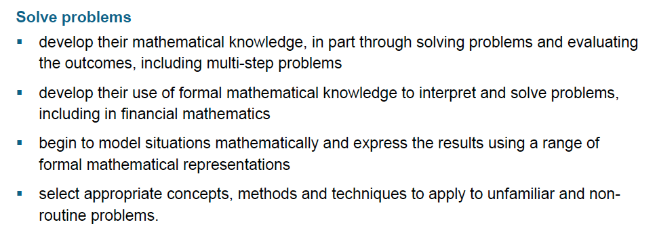
Solve problems in the NC

Slide 15
Problem solving in the New National Curriculum
Formulate
  “begin to model situations mathematically and express the results using a range of formal mathematical representations”
Employ
  “select appropriate concepts, methods and techniques to apply to unfamiliar and non- routine problems.”
Interpret
  “develop their use of formal mathematical knowledge to interpret and solve problems, including in financial mathematics”
Evaluate
  “develop their mathematical knowledge, in part through solving problems and evaluating the outcomes, including multi-step problems”

Slide 16

GCSE (2015) Specifications should enable students to:
Develop fluency and understanding
  “develop fluent knowledge, skills and understanding of mathematical methods and concepts”
Reason and communicate mathematically
  “reason mathematically, make deductions and inferences and draw conclusions”
  “comprehend, interpret and communicate mathematical information in a variety of forms appropriate to the information and context.”
Solve problems
  “acquire, select and apply mathematical techniques to solve problems”
Notes:
Wales is slightly different.
1. Solve mathematical problems
2. Communicate mathematically
3. Reason mathematically

Slide 17
GCSE Assessment Objectives
2015 Assessment Objectives |  | Weighting
 |  | Higher | Foundation
AO1 | Develop fluency and understanding Use and apply standard techniques | 40% | 50%
AO2 | Reason and communicate Reason, interpret and communicate mathematically | 30% | 25%
AO3 | Solve problems Solve problems within mathematics and in other contexts | 30% | 25%

Slide 18
.. and in the GCSE Assessment Objectives
AO3 |  | Weighting
 | Formulate translate problems in mathematical or non-mathematical contexts into a process or a series of mathematical processes Employ make and use connections between different parts of mathematics Interpret interpret results in the context of the given problem Evaluate evaluate methods used and results obtained evaluate solutions to identify how they may have been affected by assumptions made. | 30% (Higher) 25% (Foundation)
Notes:
Discuss student roles.
Designer, Planner ....

Slide 19

Maths = Disparate skills?
  “ ..too much teaching concentrated on the acquisition of disparate skills that enabled pupils to pass tests and examinations but did not equip them for the next stage of education, work and life.
  Problem-solving and investigative skills were rarely integral to learning except in the best schools where they were at the heart of learning mathematics.”
(Ofsted, May 2012)
Notes:
“While the best teaching developed pupils’ conceptual understanding alongside their fluent recall of knowledge, and confidence in problem solving, too much teaching concentrated on the acquisition of disparate skills that enabled pupils to pass tests and examinations but did not equip them for the next stage of education, work and life.
Problem-solving and investigative skills were rarely integral to learning except in the best schools where they were at the heart of learning mathematics.”

Slide 20

“I used to think that if I taught them all the pieces, they could put them together. Now I know they can’t.”

Slide 21
PD: Lessons in Mathematical Problem Solving (LEMAPS)
Lessons are developed with a specific research focus in mind.
  For example:
How can we enable students to plan strategically and monitor their approaches more effectively?
Identify research focus
Disseminate
Plan research lesson
Revise research lesson
Teach research lesson
Analyze research lesson
Notes:
This Nuffield funded project seeks proof-of-concept of new and sustainable models of partnerships that support professional learning in secondary school mathematics with the involvement of Higher Education. The focus is on improving students’ problem-solving capabilities in mathematics.
The project will build on the outcomes of Bowland Maths funded pilot that explored the use of Japanese lesson study principles to consider the teaching of mathematical problem solving.
Research: the project will address the following questions:
1. How can models of professional learning for secondary school teachers, based on lesson study, be developed and sustained within current and changing systems and structures of school governance and funding mechanisms?
2. What supporting tools would help collaborative partnerships to implement lesson study for mathematical problem solving in effective ways that are both sustainable and scalable?
Development: the project will build and develop, through formative, iterative cycles of design and improvement:
• new lesson study partnerships that exemplify a range of different effective models of operation;
• a core network of expertise ready to support emerging new partnerships;
• a toolkit of resources that will support: (i) the key players in initiating, organising and sustaining professional learning communities (ii) participants in lesson study.

Slide 22
  “Mathematical literacy frequently requires devising strategies for solving problems mathematically. This involves a set of critical control processes that guide an individual to effectively recognise, formulate and solve problems. this skill is characterised as selecting or devising a plan or strategy to use mathematics to solve problems arising from a task or context, as well as guiding its implementation. This mathematical capability can be demanded at any of the stages of the problem solving process.”
  (PISA 2015)

Slide 23
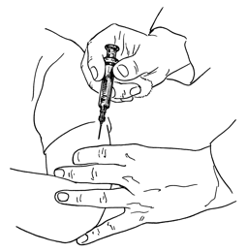
Outbreak
A disease has started to spread around the city. If you get the disease you only have hours to live. Our city has been put under quarantine; no one in or out.
The good news is you are able to help.
The scientists from the Research and Development Department have worked flat out and have managed to put together two vaccinations.
• Vaccination A is 100% effective and costs £12.00 per vaccine.
• Vaccination B is 70% effective and costs £5.20 per vaccine.
We only have a budget of £5,000,000 maximum.
Your task is to recommend:
• How many of each vaccine should we make?
• Who will get those vaccines?
Remember, I want you to be able to explain all your decisions.

Slide 24
Outbreak!
Occupation | Number in population
Medical workers (doctors, nurses) | 75600
Key service workers (electricity, refuse) | 113000
Food shop personnel | 113000
Farmers and food producers | 85100
Other shop workers | 104000
Other professionals.... teachers, lawyers, etc. | 123000
Other trades people ... decorators, plumbers, mechanics, etc. | 85100
Retired people | 86400
Students and school students | 94600
Children under 5 | 66200
Total | 946000

Slide 25
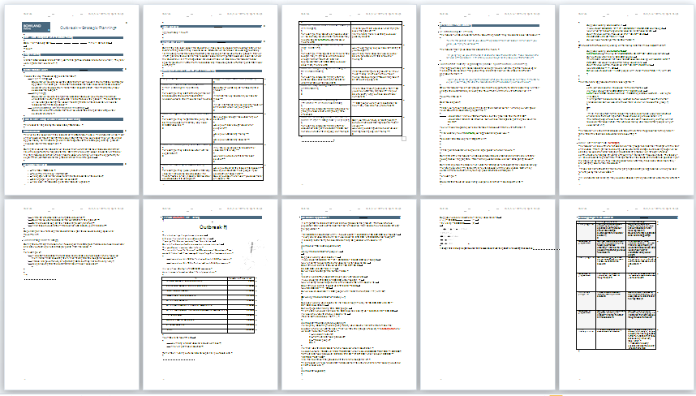
Research lesson – lesson plan
Anticipated issues table
Progression grid

Slide 26
How can we anticipate student responses?
In a preliminary lesson, the class attempted the task individually in silence.
Responses were collected and analyzed according to the approaches taken.
Teachers prepared formative feedback questions for students.

Slide 27
Issues arising from initial attempts
Calculations before planning
Ignoring constraints.
Not justifying decisions made.
Leaping to conclusions: “Vaccine A is more effective so just use that”
Not understanding concept of a budget
Overwhelmed by large numbers
Not grasping meaning of calculations
Not understanding “effectiveness” of each vaccination:
  “70% effective so 70% must survive”.
Becoming confused between numbers representing money or people

Slide 28
Anticipated issues table
Key Issue | Suggested questions or prompts
Students start detailed calculations before planning an approach | Describe in words a plan for tackling this problem. What are the key decisions you have to make? Which information are you going to focus on at the start, which will you ignore?
Students ignore one or more constraints. | Do you have enough resources for your solution? Have you made enough vaccine for everyone? Have you wasted any money? Have you wasted any vaccine?
Students do not justify decisions made. | Why have you chosen to allocate the vaccines in this way? How can you be sure this is the best solution?
Students leap to conclusions | Have you taken all the issues into account? Could you vaccinate more people if you used some of vaccine B? Could you save more lives if you used more of vaccine A?

Slide 29
 | Strategic planning | Monitoring work
Little progress | Attempts to work towards a solution by carrying out operations with figures but shows little strategic awareness that will lead to a solution | Carries out own calculations without ever stopping to reflect or think about what is being achieved. Does not stop to consider alternative approaches.
Questions | Can you write down a plan for completing the task? What other pieces of information must you consider? | When you have finished this calculation, what will you do next? How will you organise your work?
Some progress | Carries out appropriate and correct calculations but does not take constraints into account. | Considers alternative approaches by comparing own method with others, but this has no impact on own approach. Pursue an inefficient approach.
Questions | Are there other pieces of information you have not thought about? | Look carefully at your partner’s work? What ideas does it contain that will help you?
Substantial progress | Works towards a solution logically reaching a viable solution | Considers the work of others. Compares this approach and tries to make use of it. Finds it difficult to discriminate efficient/ inefficient approaches.
Questions | Can you think of an alternative approach to solving this problem? What be the effect on the outcome? | Which of these two ideas is more powerful? Why is this? Which approach would still work if we changed the numbers in the problem?
Task accomplished | Arrives at a solution having considered alternatives. | Engages thoughtfully with the work of others. Selects and uses powerful approaches.

Slide 30
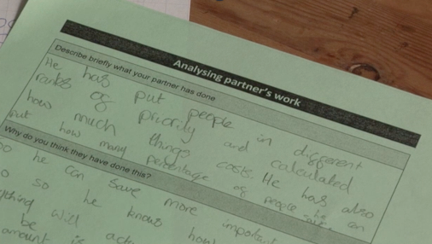
See Case Study

Slide 31

What are the characteristics of effective professional development?
It is:
sustained over substantial periods of time
collaborative within mathematics departments/teams
informed by outside expertise
evidence-based/research-informed
attentive to the development of the mathematics itself.
(RECME, 2009)

Slide 32
Lesson Study
The project takes a distinctive view of lesson study:
it should be embedded in a culture of teacher research/inquiry into professional practice
it should have the support of mathematics education expertise, typically found in universities.
The project concerns problem solving in mathematics, that is, the process of tackling extended, unstructured problems that require students to model situations with mathematics, make reasoned assumptions, construct chains of reasoning and interpret solutions in context.

Slide 33
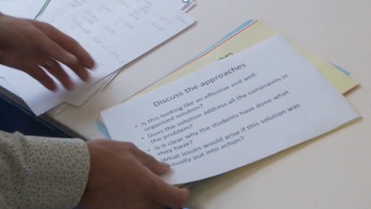
See Case Study

Slide 34
Timeline
Exploratory phase /
Pilot study
July
2012
December
2013
R & D
December
2015
9 schools
2 clusters (London and Nottingham)
3 teachers in each school.
1 research lesson per term per school with joint observations and analysis across schools within their cluster (27 lessons in total)
Research: sustainability and scalability
Design: lesson study community toolkit
System level: systems and structures
School level: Teacher groups (working across schools)
Classroom level: pedagogies for problem solving

Slide 35
Timeline
Year 1 (2014)
8-10 clusters of schools
Approx 3 teachers in each school
HE link
1 research lesson per term per school with joint observations and analysis across schools
1 workshop per term
Year 2 (2014)
Additional 4 clusters of schools (approx)
December
2013
R & D
December
2015
Research: sustainability and scalability
Design: lesson study toolkit
System level: systems and structures
School level: Teacher groups (working across schools)
Classroom level: pedagogies for problem solving

Slide 36
Challenges
  Understanding of problem solving
  Developing collaborative lesson study groups in a climate of competition between schools
  Ensuring the involvement of outside expertise
  Supporting lesson study group “leaders”
  Planning for sustainability
  Potential rapid growth

Slide 37
For further details go to
http://www.nottingham.ac.uk/education/research/crme/index.aspx
To join the mailing list, contact
Geoffrey.wake@nottingham.ac.uk

