Slide 1

Counteracting failure? Working with GCSE mathematics resit students to change attitudes and achievement using a Realistic Mathematics Education approach
Yvette Solomon

Slide 2
The size of the problem
Notes:
https://www.gov.uk/government/statistics/level-1-and-2-english-and-maths-16-to-18-students-2013-to-2014 released October 2015

Slide 3
GCSE resit entry and achievement of Grade A*- C as a proportion of those who did not achieve by age 16

Slide 4

GCSE resit achievement rates

Slide 5
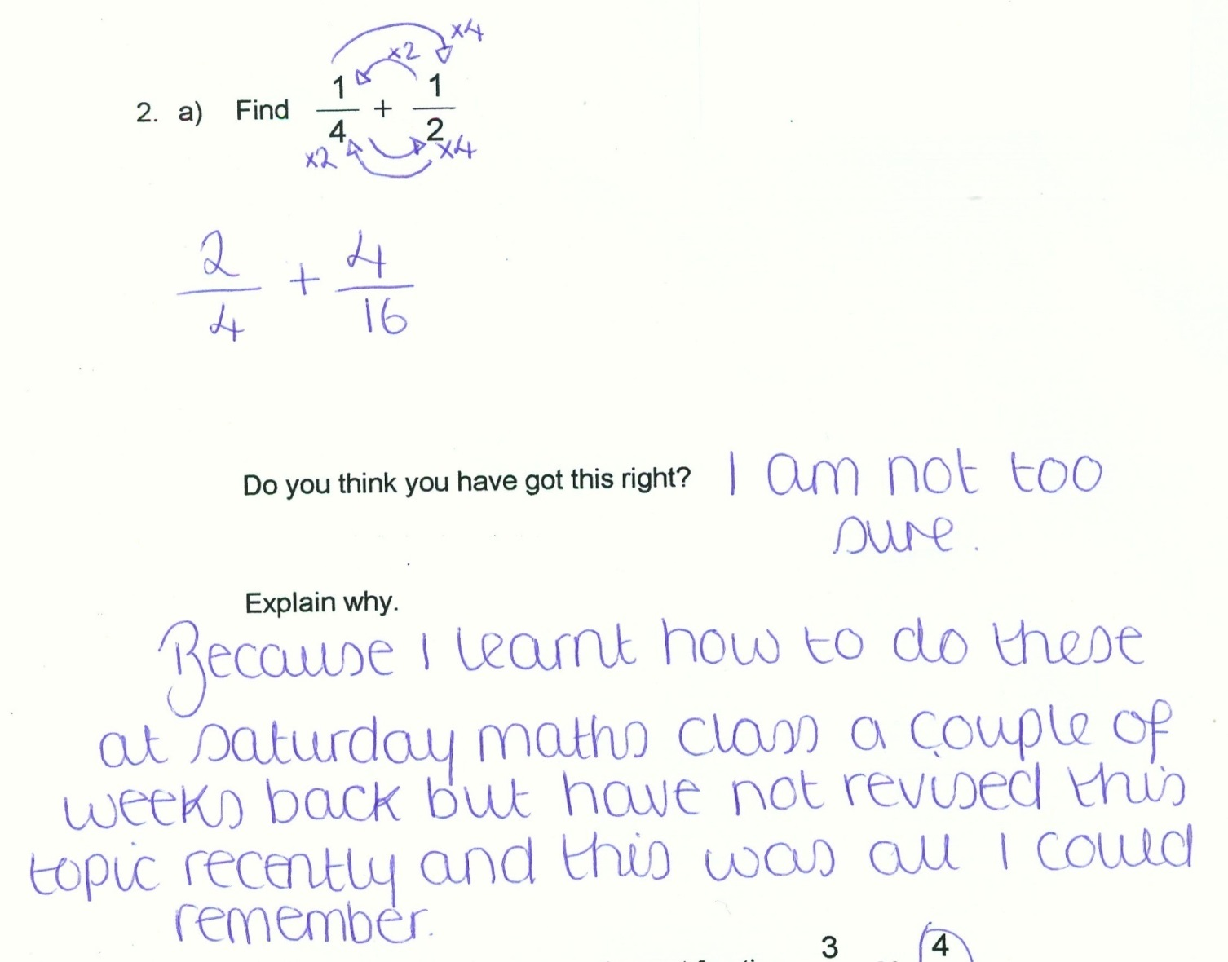
The issue 1
Notes:
A Year 11 student misremembering her rule for adding fractions

Slide 6
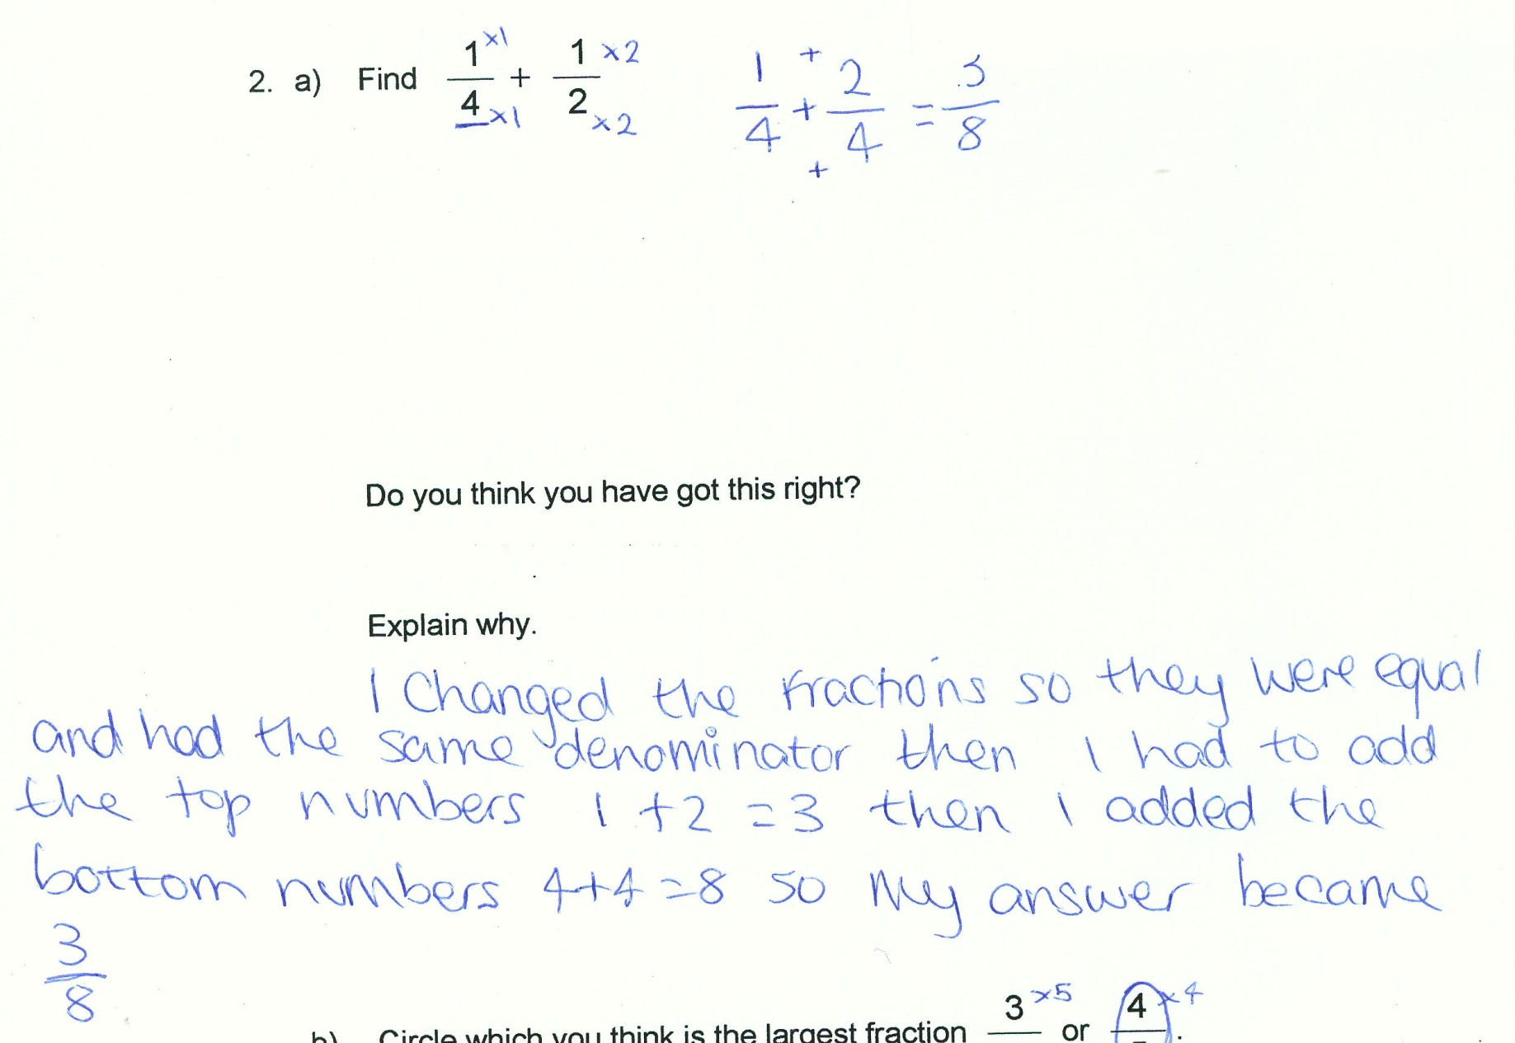
The issue 2
Notes:
A Year 11 student who correctly remembers to make the fractions the same type and then applies an incorrect rule.

Slide 7
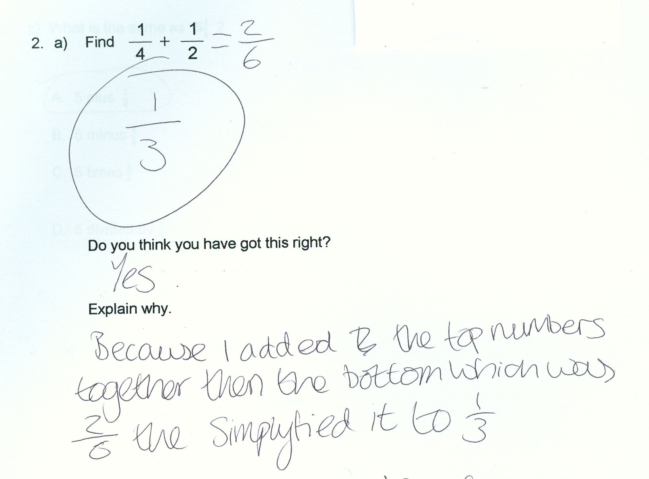
The issue 3
Notes:
A very common incorrect approach is shown. The student views the fractions as a series of numbers to operate on in the way we operate on whole numbers. There is no attempt to consider the meaning of $\frac{1}{4}$ and $\frac{1}{2}$ as quantities in their own right.

Slide 8
GCSE resit cohort – the issues
Memory of formal methods can be poor
Use of misremembered strategies – ‘doing something with the numbers’
Desire to use informal methods – but these tend not to have been developed to a more efficient level
Repeated failures in the examination
Lack of confidence and a belief in fixed ability
Assumption that ‘maths doesn’t have to make sense’

Slide 9
A way forward? Enhancing student engagement and progress
GCSE resit: we know that short courses which are ‘more of the same’ have limited success
Realistic Mathematics Education-based approach aims to enhance achievement through
  support for deeper and longer-term understanding
  changing students’ negative perceptions of mathematics and their own ability (e.g. Gravemeijer, Van den Heuvel, & Streefland, 1990)
Issues:
  Resistance and the power of the algorithm
  What do we mean by progress?

Slide 10
The GCSE resit study
Quasi-experimental mixed methods design with 4 project and 4 control classes in three sites:
  2 Further Education colleges, 1 6th form in an 11-18 school
Intervention comprises number and algebra modules
  sustained use of context and models to support the process of formalisation while retaining ‘sense-making’
Data include:
  Quantitative: module-specific pre- and post-tests, delayed post-test, attitude measure (adapted from Reiss et al UPMAP measure 2008-2012)
  Qualitative: case-studies - interviews with both project and control students, smart pen in-class data from project students, video post-test data based on test performance with both control and project students, all lessons videoed

Slide 11
Realistic Mathematics Education (RME)- the Dutch approach
Well researched activities encourage students to move from informal to formal representations of mathematics
Use of context is sustained throughout
Use of models to support student development
Progress towards formal notions seen as a long term process

Slide 12
Joel: ‘giving it a go’ – but still lacking in confidence
“[Sue is] trying to get us to think about it a different way … Like if I was doing a test then that’s how I’d think about how to work the questions out, but … just because I think that way doesn’t mean that I’m going to get a question right, because like I say I’m not that great at maths, so I still struggle to answer the question correctly.”

Slide 13
Pre- and post-tests – Joel: from 1/17 to 10/17
Notes:
Drawing a bar representation of the problem, this Year 12 student has used repeated halving with the bar to identify the value of $\frac{1}{2}$ and $\frac{1}{8}$ and hence $\frac{5}{8}$ of £600. He moved from 1/17 in the Number pre-test to 10/17 in the post-test

Slide 14
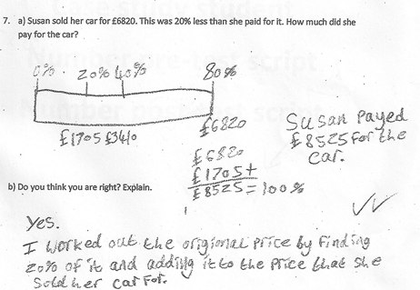
Reverse percentage success – Joel again
Notes:
Reverse percentage problems are known to be difficult. Here drawing the bar representation of the problem has enabled Joel to devise an appropriate strategy for correctly finding the original price.

Slide 15
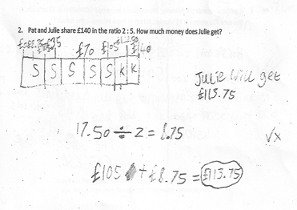
BUT: insecurity with the model and reversion to algorithmic approaches
Notes:
Here Joel is able to produce a potentially useful bar representation of the problem. His tendency to fill in other quantities by halving and halving again can be seen with the addition of £70 and £35, along with his lack of appreciation that splitting after 3 of the 7 equal parts does not constitute the middle of the bar. When interviewed Joel revealed a lack of understanding of the relationship between finding one piece of the seven piece bar and the calculation 140 ÷7. Instead he relied upon a guess and check strategy starting with one piece worth £ ?? and repeatedly adding to see whether this totalled £140.

Slide 16
What’s in a C?
Looking at the ‘success’ stories is falling into the trap of only considering marks
What about students who did fairly well in BOTH pre- and post-tests?
Or at those who scored low in both?
We need to look closely at scripts to understand
  The teacher as developer or replacer of student knowledge
  The nature of progress towards mathematising and the potential ‘unifying’ effect of RME

Slide 17
Owning the method 1
Notes:
Pre-test above, post-test solution below. Arguably, the post-test is done less efficiently. On the pre-test, 30 copies was derived from 12 + 12 +6, whereas in the post-test 12+6+2 is used to get 20 copies, then 6+2+2 to get the other 10. But this shows flexibility albeit less efficiency, and the fact that the student clearly ‘owns’ the method.

Slide 18
Owning the method 2
Notes:
Ownership is crucial for two reasons;
Firstly, because it allows access to other questions which were previously not attempted – Question 3 was not attempted in the pre-test. Secondly, because it allows a different version of the same model to produce a full solution to Q2 (percentages). The student had not been able to answer this question in the pre-test.

Slide 19
Progress as discarding an erratic algorithm
Notes:
Here a student has persisted with a mis-remembered algorithm in the post-test but has recognised that they are not arriving at a sensible solution. They then moved to using the bar successfully on this question. Although they did not score well on the post-test, they showed progress in terms of thinking about the usefulness of the algorithm and turning to a sense-making alternative.

Slide 20
Progress as ‘’making a start”/ “something to work with”
Notes:
Although the student has not arrived at a correct solution, their attempt to use the bar here provides the teacher with more to work on in comparison with their pre-test answer which mis-used an algorithm to arrive at an unlikely answer (540 seconds).

Slide 21
Clare: “just tell me how to do it”: Resistance to the RME approach
“I think the pictures thing, … I just think it’s wrong to do it and the other people in the class, they try and explain it. It just confuses me … I think my way is an easier way, because I just go straight to it. … I only find it confusing when the rest explain it … they’ll be finding half and they have to add another one when they could just do a division and then it would give their answer.”

Slide 22
A host teachers’ worries about time
“With every other group I am three or four weeks ahead of [the RME one] …. But you’re right about the underlying understanding being really really important, so I’m pulled two ways … I really like what you do and buy into it, and the other side of me is saying ‘damn, with this group I’ve still got to cover this this and this, and when am I going to do it?’, because when I start teaching again I’ve still got things on the scheme of work to do”

Slide 23
Concluding comments
There are real pressures to gain a grade C quickly, but students who are at Grade E or below – who risk failing AGAIN - can benefit from RME
Students who narrowly missed a grade C may gain one through standard teaching, but potentially at the expense of their understanding and their future engagement with mathematics
Mathematics needs to make sense – a major issue is changing students’ expectations and aspirations but also ….
…. We need to address these questions:
  ‘What’s in a C?’
  ‘What is progress?’

Slide 24

The Nuffield Foundation is an endowed charitable trust that aims to improve social well-being in the widest sense. It funds research and innovation in education and social policy and also works to build capacity in education, science and social science research. The Nuffield Foundation has funded this project, but the views expressed are those of the authors and not necessarily those of the Foundation. More information is available at www.nuffieldfoundation.org

