Slide 1
Horticulture
Science in the workplace

Slide 2
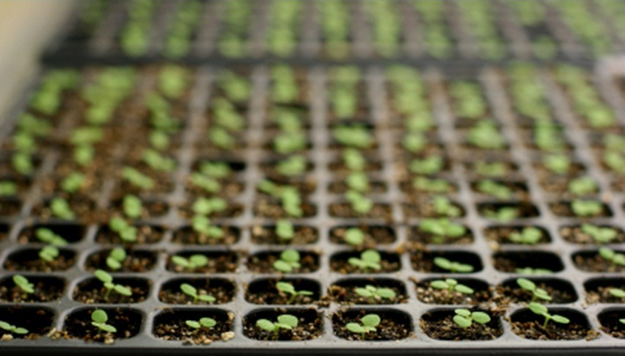

Slide 3
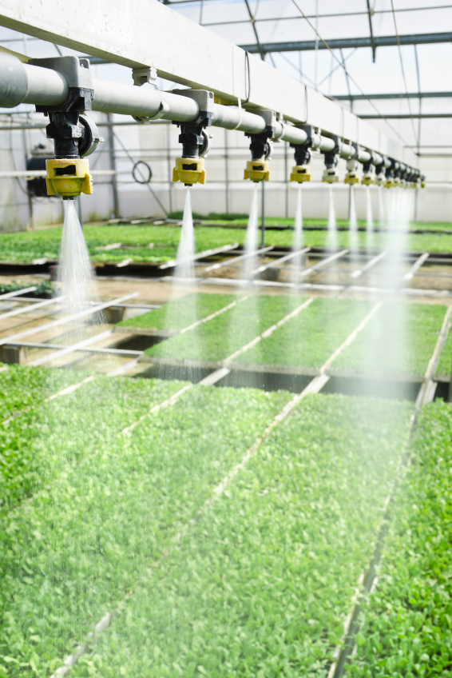

Slide 4
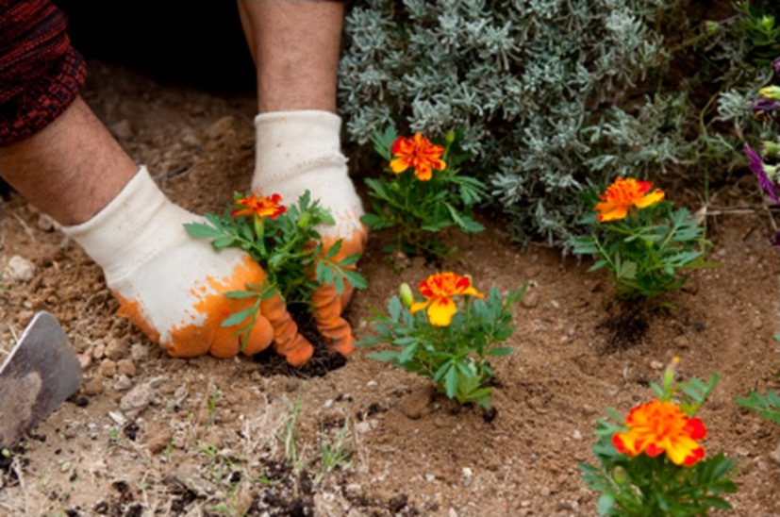

Slide 5
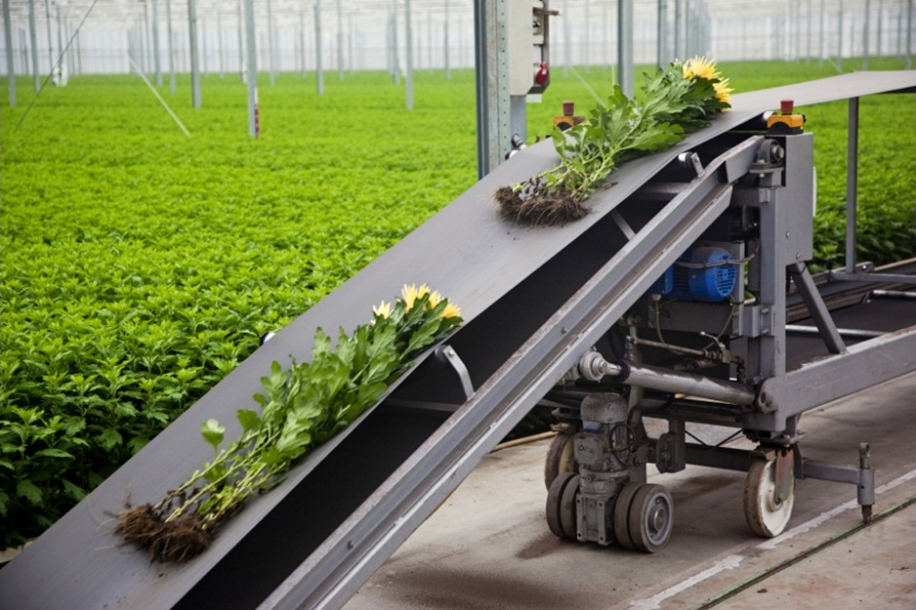

Slide 6


Slide 7


Slide 8
Learning outcomes
Carry out an investigation to find the answer to a genuine problem
Report on the outcomes of your investigation
State three reasons why science is important in the horticulture industry

Slide 9

mineral nutrients
water
What do plants need to grow?
sunlight
carbon dioxide
warmth

Slide 10

I’ve been reading an article about the environmental consequences of using peat.
But I’ve also heard that peat is really good at holding water.

Slide 11
What I want to know is:
How much water does peat hold compared with other growing media?
I need you to investigate
and provide a report.

