Slide 1
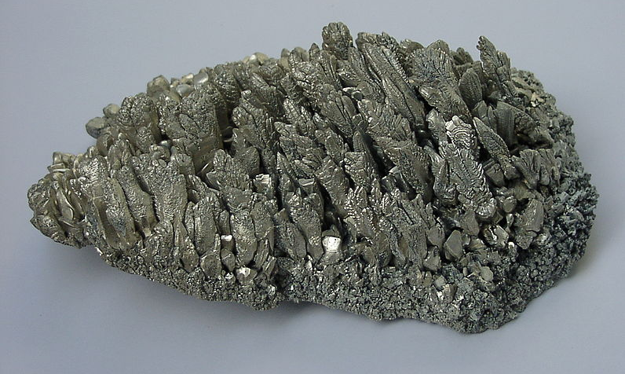
Magnesium and carbon dioxide
Practical Work for Learning

Slide 2
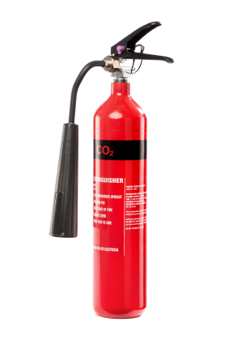
Carbon dioxide fire extinguishers
Why do some fire extinguishers contain carbon dioxide?

Slide 3
Learning Outcomes
use your knowledge of the reactivity series and the fire triangle to make predictions about the outcome of reactions
give an explanation for what happens when burning magnesium is added to carbon dioxide
consider and evaluate other peoples’ arguments.

Slide 4
Predict
What will happen to a piece of magnesium that is placed into a Bunsen flame, removed, and held in the air?

Slide 5
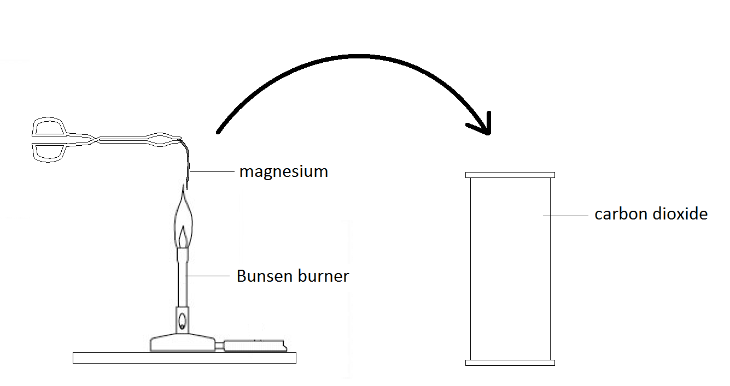
Burning magnesium in carbon dioxide
What will happen when burning magnesium is placed in carbon dioxide?

Slide 6
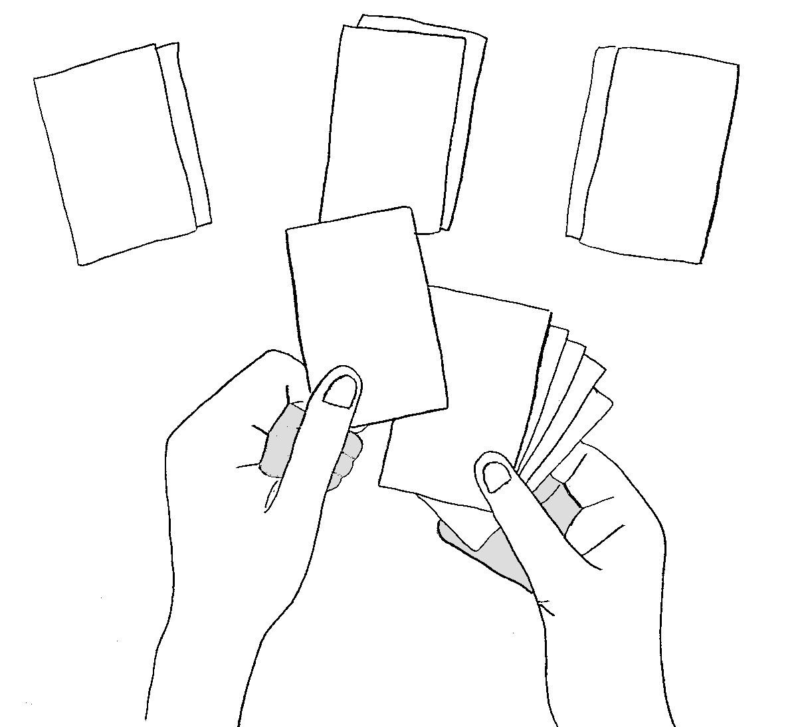
Making a prediction
Divide the cards into:
evidence suggesting that the magnesium will continue to burn
evidence suggesting that the magnesium will go out
cards supporting neither argument.

Slide 7
Making a prediction
Using the evidence on the cards – and any additional knowledge you have – decide what you think is going to happen.

Slide 8
Making a strong argument
Select 2 or 3 cards which provide the strongest argument for your prediction.
Explain why they support your prediction.
Select 2 or 3 cards which provide the strongest evidence for the opposing prediction.
For each of these explain how your prediction can still be valid.

Slide 9
Making a strong argument
Write your prediction on a mini white-board and be prepared to share your arguments with the class.

Slide 10
Making a strong argument
Check your argument against these criteria.
Is the claim clear?
Is the claim linked to the evidence?
Does the evidence support the claim?
How could the argument be improved?

Slide 11
Explain
Write an explanation for what you saw.
You should include:
A chemical equation
What the black specks on the gas jar were
Select the evidence cards which best support your explanation.
Extension: Choose an evidence card which does not support your explanation. Explain how your explanation can still be valid.

Slide 12
Some burning sodium is put into a gas jar of carbon dioxide. Alice and Barney predict what will happen.
The fire will go out because there is no oxygen present.
Alice
The sodium will burn in the carbon dioxide because sodium is a very reactive metal.
Who do you agree with?
In your answer, give evidence to support the prediction you agree with and evidence against the prediction you disagree with.
Barney

