Slide 1
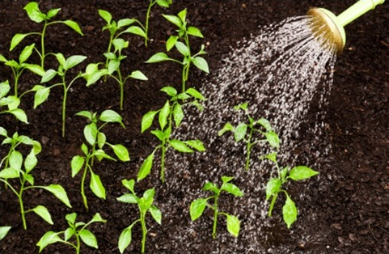
Using a pot model to represent osmosis
Practical Work for Learning

Slide 2
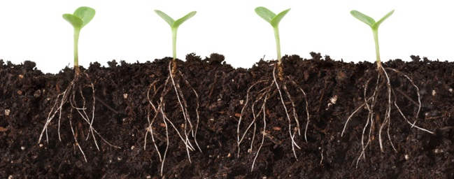
Plants and water
Plants take up water through their roots, from the soil.
But how does this happen?

Slide 3
Learning outcomes
You will be able to…
explain the overall movement of water into and out of plant cells
construct and apply a model of osmosis

Slide 4
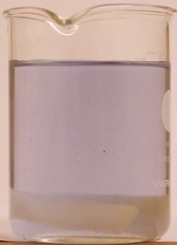
Set up your potato practical
Dry a piece of potato (of around 15 g) on a paper towel. Accurately weigh it and put it into a beaker of distilled water.
Weigh a second similar piece from the same potato. Put this piece into a beaker of sugar (sucrose) solution.
Record the mass of the potato pieces before you place them into the beakers.
Leave for around 10 minutes.
distilled water
potato
sucrose solution

Slide 5
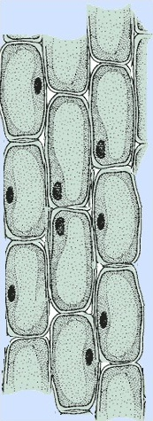
Plant cells – what you already know
Cell walls are permeable. They allow water and most dissolved molecules to pass through.
cell wall
cell membrane
nucleus
cytoplasm
vacuole
Cell membranes are partially permeable.
They allow water through but are a barrier to many solutes such as sugars.
Section of plant tissue

Slide 6
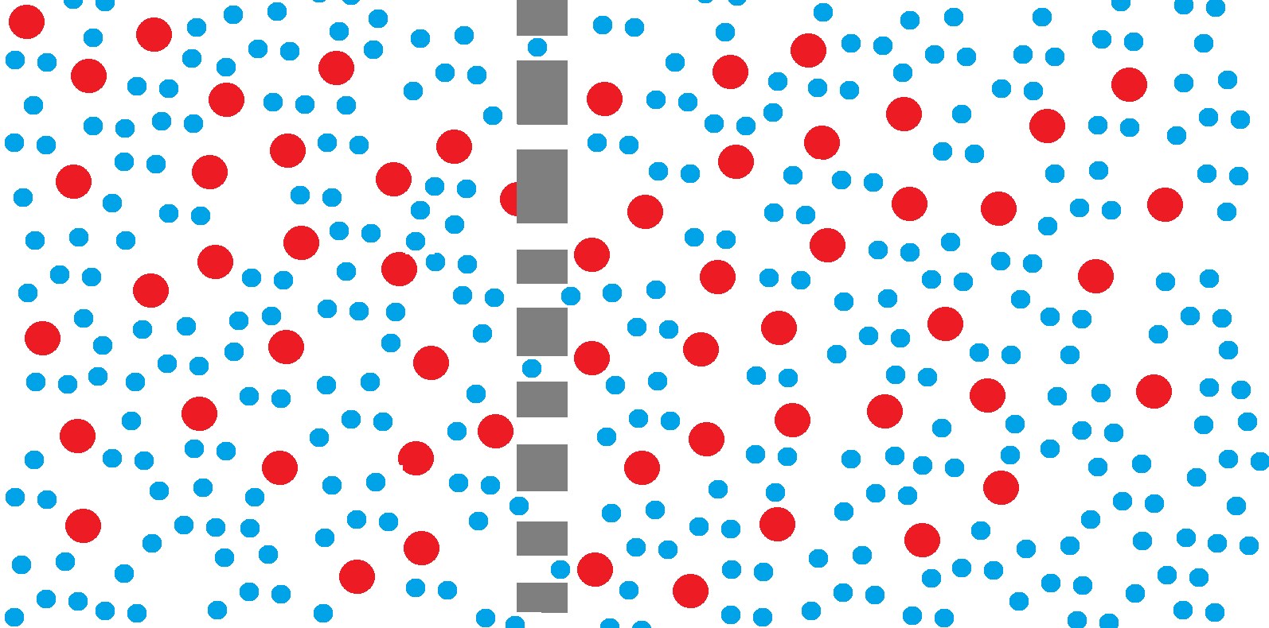
Osmosis is the overall movement of water, by diffusion, through a partially-permeable membrane.
sucrose molecule
water molecule
Partially-permeable membrane
water molecules pass freely through the membrane
sucrose molecules are too large to pass through

Slide 7
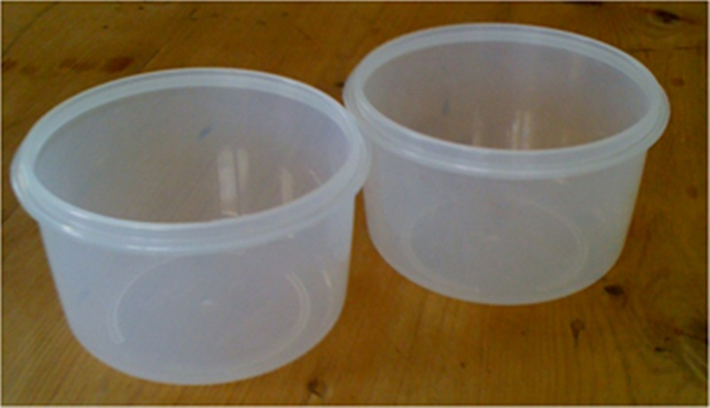
A ‘pot model’ for osmosis
Take two small pots or beakers.
These represent a cell and the surrounding solution

Slide 8
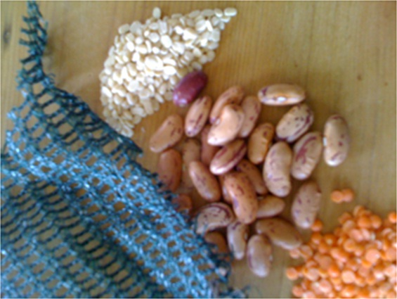
You will also need items like these to represent: - sucrose (solute) molecules - water molecules (in two colours) - a partially-permeable membrane
white split lentils
beans
garden netting
orange split lentils

Slide 9
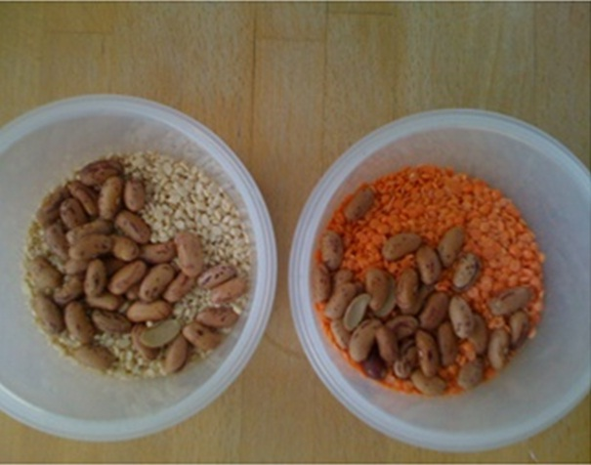
Put the same amount of ‘water’ molecules in each pot but use a different colour in each. The number of ‘sucrose’ molecules you put in will depend on how concentrated the solution is.

Slide 10
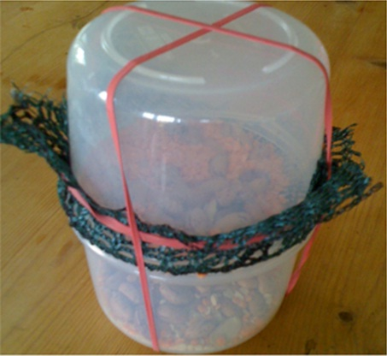
cell
Use elastic bands to secure the ‘membrane’ and fasten the ‘cell’ and ‘surrounding solution’ together.
surrounding solution

Slide 11
Predict what will happen when you shake the pots vigorously up and down.
What do you expect to see when you look in the two pots after shaking?
Simulate ‘osmosis’ by shaking the pots.
Hold the pots firmly together with both hands.
Shake vigorously for 10 seconds.
Turn the pots over after each few shakes. This is so the ‘cell’ is on the top and on the bottom for the same time.

Slide 12
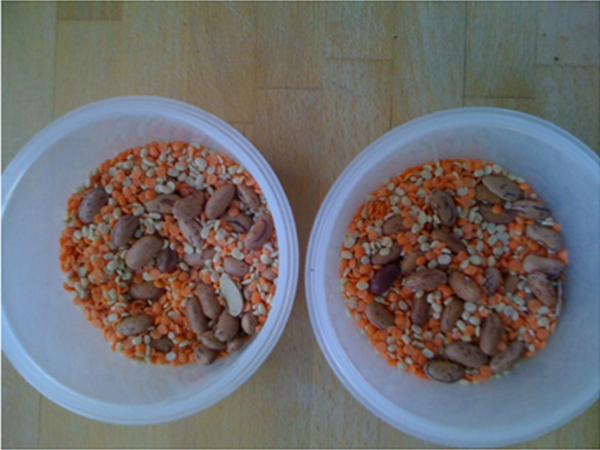
Describe what you see.

Slide 13
Compare your ‘pot model’ with the model of osmosis in this diagram.
sucrose molecule
water molecule
partially-permeable membrane
randomly moving molecules bump into the membrane
water molecules pass freely through the membrane
sucrose molecules are too large to pass through

Slide 14
Collect evidence
Remove the potato from the distilled water. Dry it on a paper towel and weigh it.
Remove the potato from the sugar (sucrose) solution.
Dry it on a paper towel and weigh it.
Have the potato pieces stayed the same, gained mass or lost mass?
Does the evidence match your prediction?

Slide 15
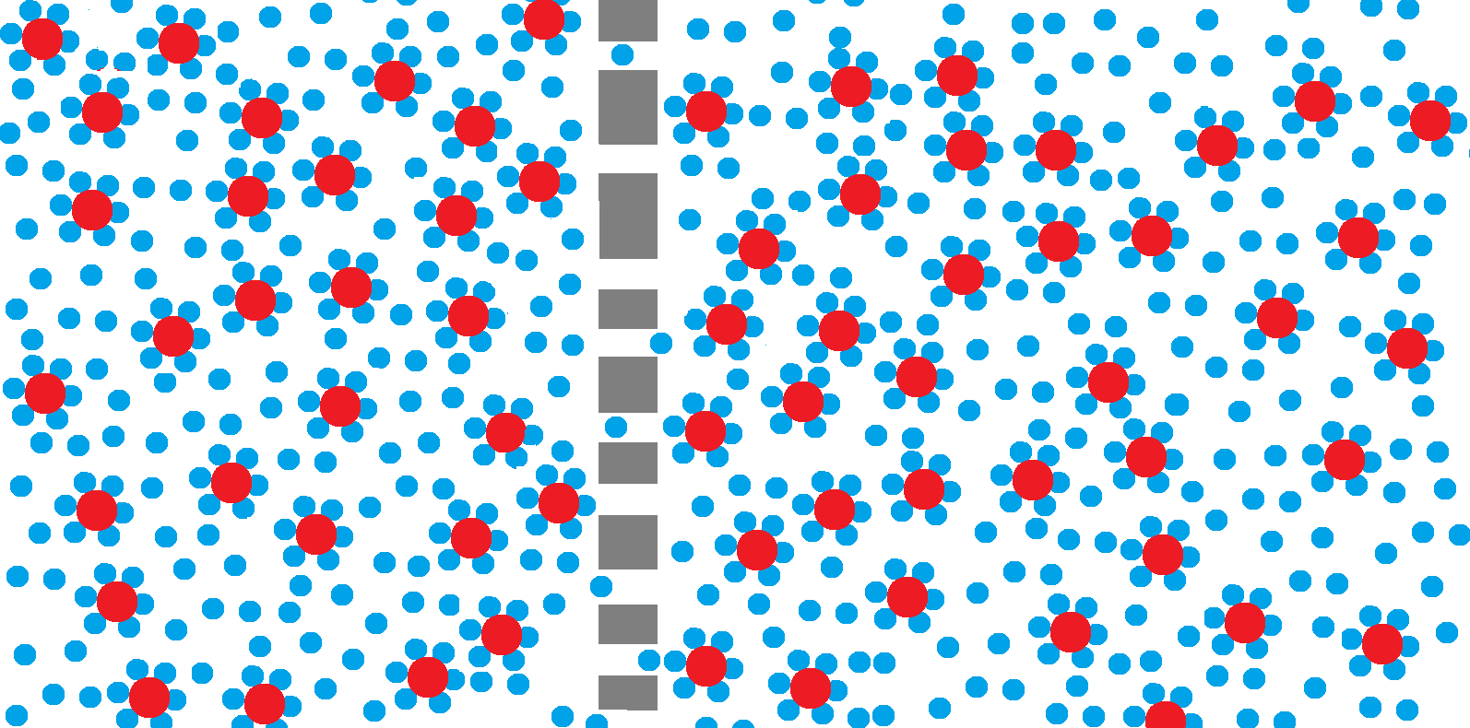
Revising the model When sucrose dissolves in water, weak bonds form between water and sucrose molecules. These bonds make it more difficult for water to move out of the solution by osmosis.
free water molecules pass through the membrane
sucrose molecules and the water molecules, which are weakly bonded to them, cannot pass through

Slide 16
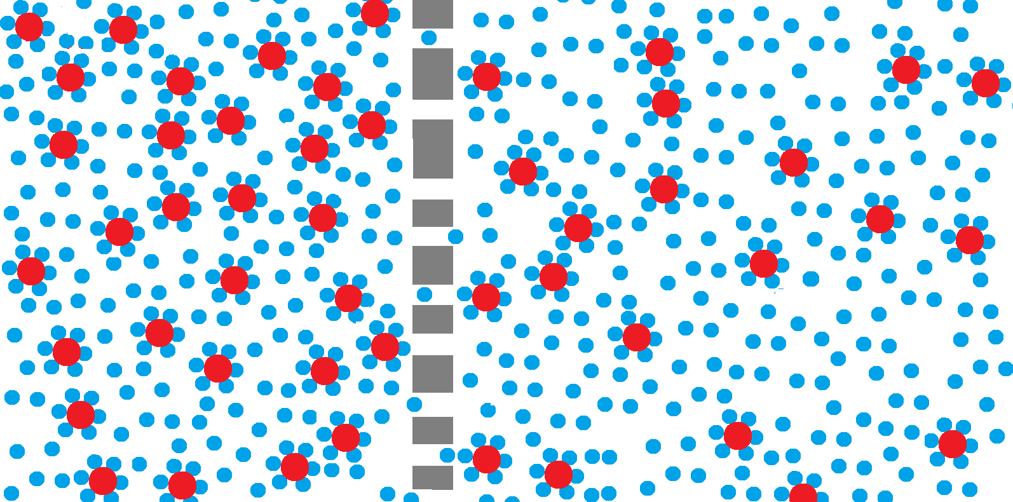
Water molecules pass through a cell membrane in both directions. Water can pass more freely from a less concentrated solution to a more concentrated solution than the other way around. Overall movement of water is then in one direction.
Predict the overall movement of water in this diagram.

Slide 17
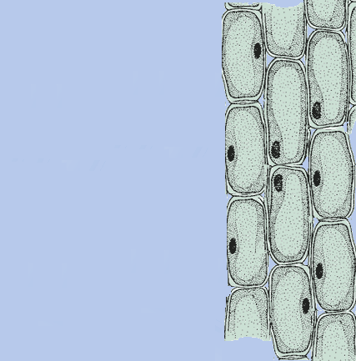
If the concentration of the solution inside the potato cells is different from the concentration of the surrounding solution, there will be overall movement of water by osmosis.
surrounding solution
potato cells

Slide 18
Osmosis: an example of diffusion
Osmosis is a special case of diffusion.
Osmosis happens when there is a partially-permeable membrane separating two solutions with different concentrations of dissolved salts or sugars.
Osmosis is the overall movement of water from a dilute to a more concentrated solution through a partially-permeable membrane.

Slide 19
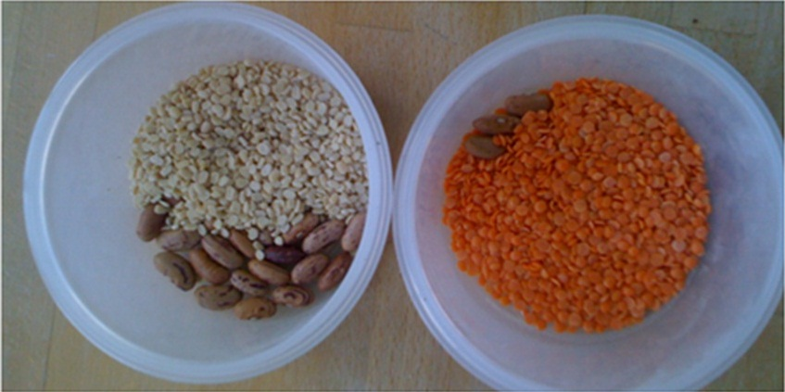
How could you adapt the pot model to take account of the bonds between water and sucrose?
Would your new pot model make more accurate predictions of water movement?

