Slide 1
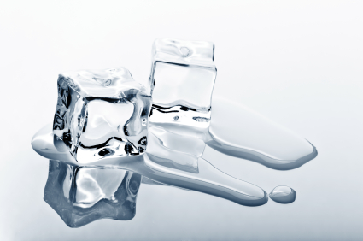
Melting ice
Practical Work for Learning

Slide 2
Learning outcomes
generate and evaluate scientific arguments
present a scientific argument using words and diagrams
describe how energy is transferred through a solid conductor from higher to lower temperature
apply ideas about energy transfer by thermal conduction in unfamiliar situations.

Slide 3
Comparing the two blocks:
plastic and metal
Similarities | Differences

Slide 4
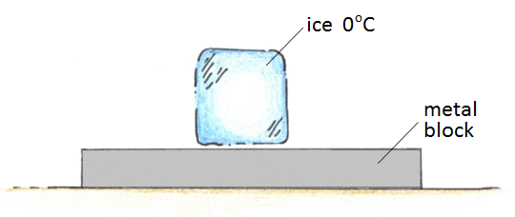
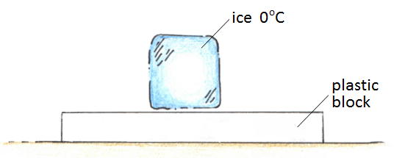
Predict
Which ice cube will melt first?
Why?
Why does ice melt?
Why might one ice cube melt more quickly than the other?

Slide 5
Observe
Describe what you saw happen
Are the results what you predicted?

Slide 6
Explain
Write a scientific explanation of what you saw happening.
Use these terms in your explanation:
temperature
energy
conduction
Extension: why does metal feel colder to touch than plastic?

Slide 7
Melting Ice
Watch video

Slide 8
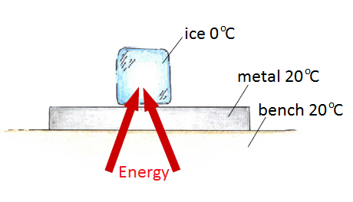
Diagram of energy flow into ice

Slide 9
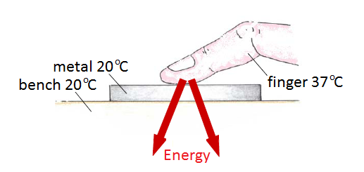
Diagram of energy flow out of finger

Slide 10
Further Questions
Ice melts more quickly on a metal block than on a plastic one. Would the result be different if ice cubes were placed in a metal box and a plastic box, so that they were completely enclosed?
You are supplied with samples of several different materials. How could you adapt this experiment to put them in order, from best conductor to worst conductor?
Why do some materials feel warmer to the touch than others?

